Slide 1


Understanding Communication Performance in HPC by using OSU INAM
Pouya Kousha
PhD student @ The Ohio State University
Advisor: Prof. DK Panda

Slide 2
Overview
Profiling tool challenges
Usage case
Overview of OSU INAM
Current OSU INAM features
Demo

Slide 3

Profiling Tools Perspective and Broad Challenges
There are 30+ profiling tools for HPC systems
System level vs User level
  User level novelty
Different set of users have different needs
  HPC administrators
  HPC Software developers
  Domain scientists
Different HPC layers to profile
  How to correlate them and pinpoint the problem source?
HPC Applications
Job Scheduler
MPI Library
Rank 0
Rank 1
Rank K
MPI_T
Unified and holistic view for all users
HPC Network
Communication Fabric
I/O File System
Notes:
Mentioning background of why INAM

Slide 4
Summary of existing profiling tools and their capabilities
Tools | MPI Runtime
 | Applications | Network Fabric | Job scheduler
INAM* | ✓ | ✓ | ✓
TAU | ✓ | ✓ | ✗
HPCToolkit | ✓ | ✗ | ✗
Intel Vtune | ✓ | ✗ | ✗
IPM | ✓ | ✗ | ✗
mpiP | ✓ | ✗ | ✗
Intel ITAC | ✓ | ✗ | ✗
ARM MAP | ✓ | ✗ | ✗
HVProf | ✓ | ✗ | ✗
PCP(used by XDMOD) | ✗ | ✓ | ✓
Prometheus | ✗ | ✓ | ✓
Mellanox FabricIT | ✗ | ✓ | ✗
BoxFish | ✗ | ✓ | ✗
LDMS | ✗ | ✓ | ✗
* This design has been publicly released on 06/08/2020 and is available for free here https://mvapich.cse.ohio-state.edu/tools/osu-inam/

Slide 5
Profiling Tools Perspective and Broad Challenges
Understanding the interaction between applications, MPI libraries, I/O and the communication fabric is challenging
  Find root causes for performance degradation
  Identify which layer is causing the possible issue
  Understand the internal interaction and interplay of MPI library components and network level
  Online profiling
HPC Applications
Job Scheduler
MPI Library
Rank 0
Rank 1
Rank K
MPI_T
How can we design a tool that enables holistic, real-time, scalable and in-depth understanding of communication traffic through tight integration with the MPI runtime and job scheduler?
HPC Network
Communication Fabric
I/O File System
Notes:
Mentioning background of why INAM

Slide 6

Overview of OSU InfiniBand Network Analysis and Monitoring (INAM) Tool
A network monitoring and analysis tool that is capable of analyzing traffic on the InfiniBand network with inputs from the MPI runtime
  http://mvapich.cse.ohio-state.edu/tools/osu-inam/
Monitors IB clusters in real time by querying various subnet management entities and gathering input from the MPI runtimes
Capability to analyze and profile node-level, job-level and process-level activities for MPI communication
  Point-to-Point, Collectives and RMA
Ability to filter data based on type of counters using “drop down” list
Remotely monitor various metrics of MPI processes at user specified granularity
"Job Page" to display jobs in ascending/descending order of various performance metrics in conjunction with MVAPICH2-X
Visualize the data transfer happening in a “live” or “historical” fashion for entire network, job or set of nodes
Sub-second port query and fabric discovery in less than 10 mins for ~2,000 nodes
OSU INAM v1 released (11/10/2022)
  Support for MySQL and InfluxDB as database backends
  Support for data loading progress bars on the UI for all charts
  Enhanced database insertion using InfluxDB
  Enhanced the UI APIs by making asynchronous calls for data loading
  Support for continuous queries to improve visualization performance
  Support for SLURM multi-cluster configuration
  Significantly improved database query performance when using InfluxDB
  Support for automatic data retention policy when using InfluxDB
  Support for PBS and SLURM job scheduler as config time
  Ability to gather and display Lustre I/O for MPI jobs
  Enable emulation mode to allow users to test OSU INAM tool in a sandbox environment without actual deployment
  Generate email notifications to alert users when user defined events occur
  Support to display node-/job-level CPU, Virtual Memory, and Communication Buffer utilization information for historical jobs
  Support to handle multiple job schedulers on the same fabric
  Support to collect and visualize MPI_T based performance data
  Support for MOFED 4.5, 4.6, 4.7, and 5.0
  Support for adding user-defined labels for switches to allow better readability and usability
  Support authentication for accessing the OSU INAM webpage
  Optimized webpage rendering and database fetch/purge capabilities
  Support to view connection information at port level granularity for each switch
  Support to search switches with name and lid in historical switches page
  Support to view information about Non-MPI jobs in live node page

Slide 7
OSU INAM Framework
Real-time visualization
Real-time
remote data collection
Real-time storage
Remotely discover fabric
Remotely reads port counters
Real-time storage manager
Notes:
OSU INAM is designed in such a way as to make the operation of each thread independent from the operations of the others. This modular design provides improved lock-free progress and better error handling. A state machine handles creation, execution, and destruction of each thread.

Slide 8
Flow of Using OSU INAM
Insight and Performance Recommendations
Tuning and Applying Recommendations
Job Scheduler
SLURM
PBS Torque
Notifications and Feedback
HPC/DL Applications
Co-designed Scientific Applications using Proposed MPI_T Extensions
TensorFlow
PyTorch
MxNet
I/O and MPI Traffic Interaction
Real-time Visualization
Co-designed Horovod using Proposed MPI_T Extensions
Metric Collectors
REMOTE OSU INAM
MPI Library with Support for Enhanced MPI_T-based Introspection
Enhanced MPI_T Sessions
Gathering
I/O Traffic Information
Enhanced PVAR Infrastructure
Measurements
Counters
Buckets
Timers
HPC Network
InfiniBand
Lustre, NFS
CPU/Mem Usage

Slide 9
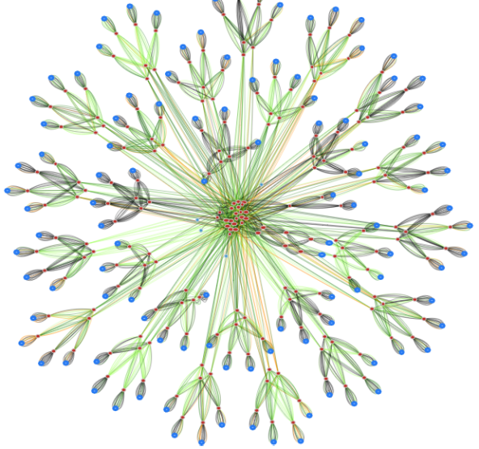
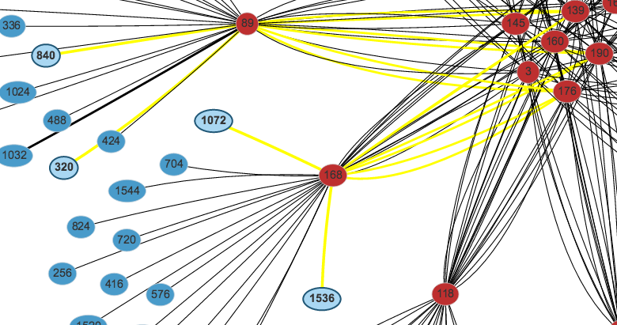
OSU INAM Features
Comet@SDSC --- Clustered View
(1,879 nodes, 212 switches, 4,377 network links)
Finding Routes Between Nodes
Show network topology of large clusters
Visualize job topology in the network
Visualize traffic pattern on different links
Quickly identify congested links/links in error state
See the history unfold – play back historical state of the network
Notes:
Visualize job topology: typically users don’t know the topology of the assigned node to them not the traffic that is happening on the root switches. Using INAM filter network view, users can see their job topology and the number of hops between nodes. Therefore a job that uses local switches compared to a job consisting of root switches and more hops may have slightly different performance.

Slide 10
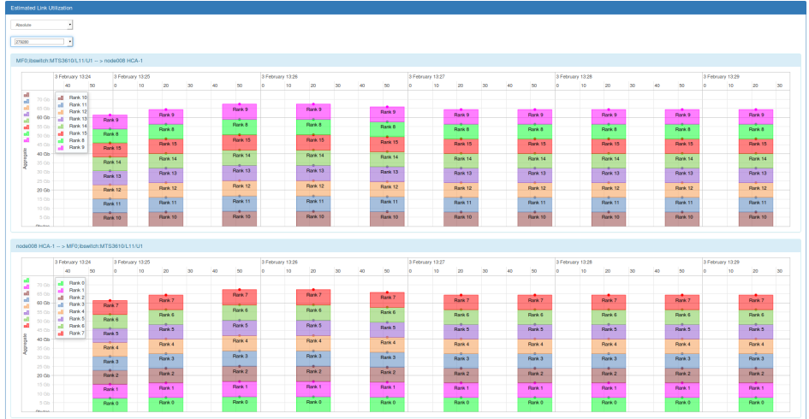
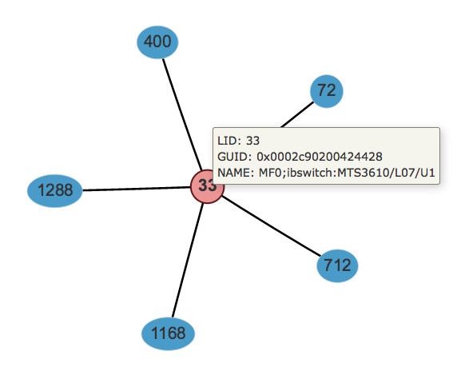
OSU INAM Features (Cont.)
Visualizing a Job (5 Nodes)
Estimated Process Level Link Utilization
Job level view
  Show different network metrics (load, error, etc.) for any live job
  Play back historical data for completed jobs to identify bottlenecks
Node level view - details per process or per node
  CPU and memory utilization for each rank/node
  Bytes sent/received for MPI operations (pt-to-pt, collective, RMA)
  Network metrics (e.g. XmitDiscard, RcvError) per rank/node
Estimated Link Utilization view
  Classify data flowing over a network link at different granularity in conjunction with MVAPICH2-X 2.2rc1
    Job level and
    Process level
More Details in Tutorial/Demo

Slide 11
Live Demo at OSC and OSU clusters

