Slide 1
High Performance MPI Over Slingshot
Kawthar Shafie Khorassani shafiekhorassani.1@osu.edu
SC 22 - OSU Booth
Network-based Computing Laboratory
Department of Computer Science and Engineering
The Ohio State University
linkedin.com/in/kawthar-shafie

Slide 2
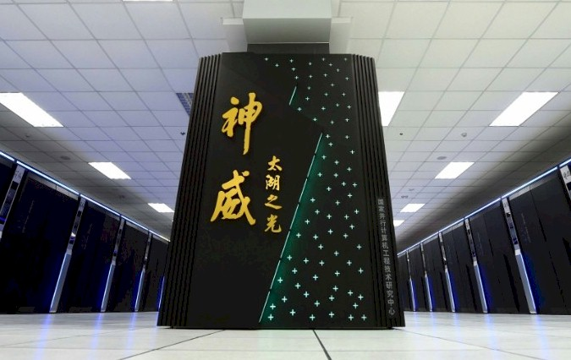
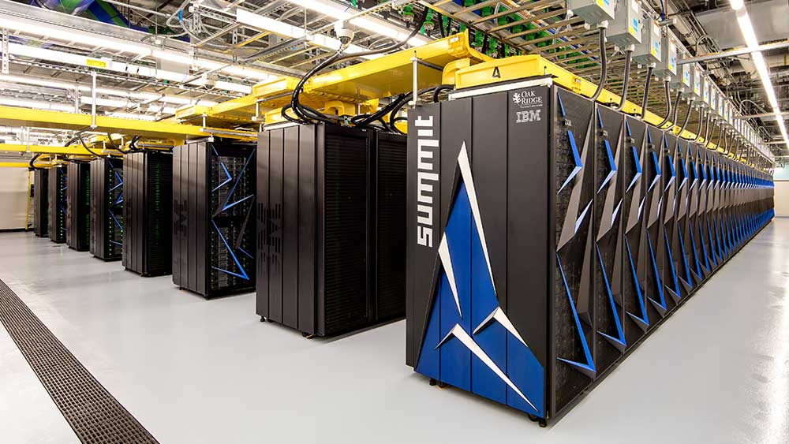
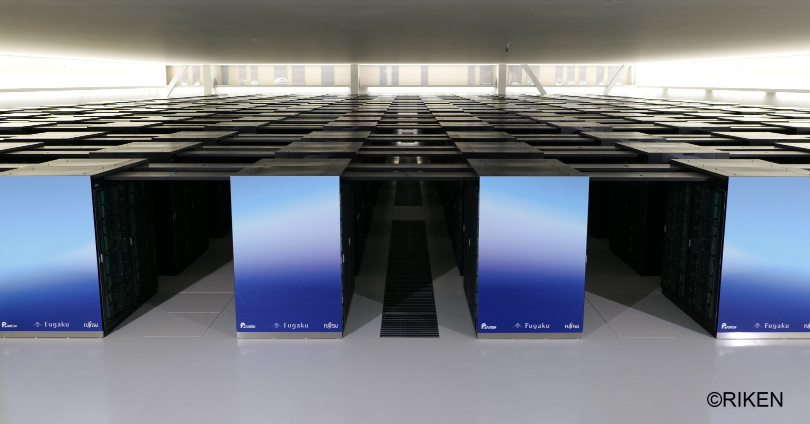

Introduction
Frontier at OLCF (#1 Supercomputer on Top500 System) - deployed with Slingshot-11 networking across nodes
MPI-level communication and performance on upcoming networking for exascale systems (i.e. Frontier & El-Capitan)
#1 Supercomputers Top500 Over Time …
Sunway TaihuLight (‘16-’17) | Summit (‘18-’19) | Fugaku (‘20-’21) | Frontier (‘22)

Slide 3
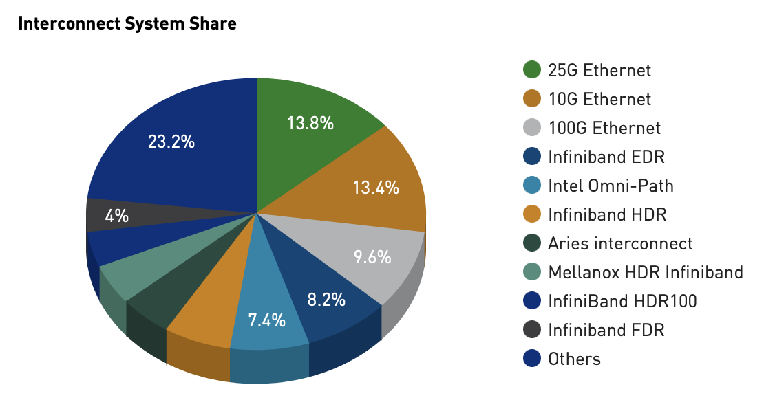
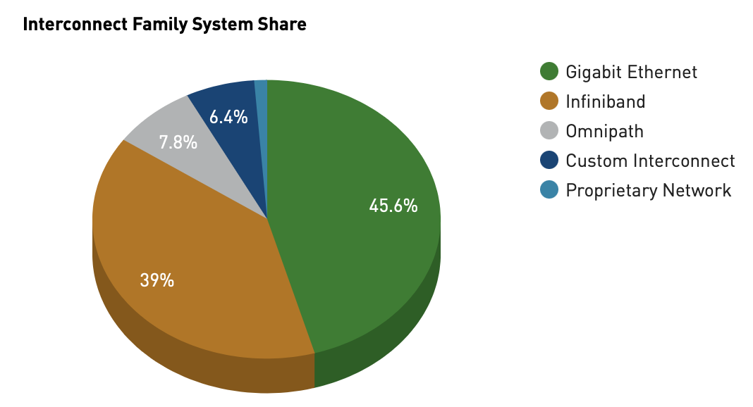
Top500 Supercomputers Interconnect Statistics
Reference: https://www.top500.org

Slide 4
Background
Many Supercomputers deployed with Mellanox Infiniband Interconnect technology
MPI Libraries have been optimized over the years to expand on Mellanox Infiniband features and support
Underlying interconnect technology critical for achieving low latency and high throughput at scale on next-generation exascale systems
Drive future research and innovations to provide scalable and competitive options in this Slingshot ecosystem.

Slide 5
Slingshot Interconnect
High-performance network designed by HPE Cray for upcoming exascale-era systems
  Based on Ethernet
  Adaptive Routing
  Congestion Control
  Isolated Workloads
Empowering the #1 Supercomputer --- Frontier
  Deployed as the interconnect for inter-node communication
  Expected to be deployed on upcoming supercomputers --> El-Capitan at LLNL, Aurora at Argonne

Slide 6
Limitations of State-of-the-art Approaches for Communication
Accessibility and deployment on early access Slingshot systems:
  Ecosystem with Slingshot-10 interconnection amongst nodes
Future accessibility and deployment on upcoming Slingshot systems (i.e. El-Capitan and Frontier):
  Slingshot-11
  Deployed over a slingshot fabric and adapter
This second-generation deployment introduces additional challenges for communication libraries to develop functionality over the underlying adapter and fabrics.

Slide 7
Experimental Setup
System & Software Details

Slide 8
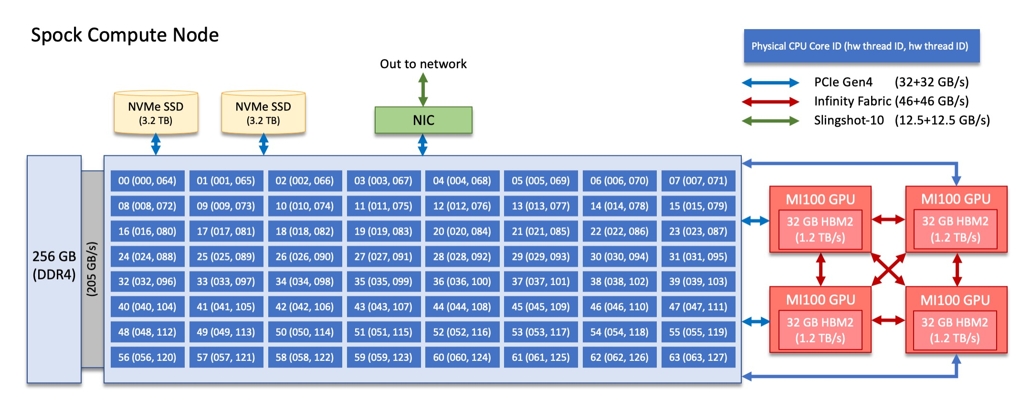
Spock Compute Node
Reference: https://docs.olcf.ornl.gov/systems/spock_quick_start_guide.html

Slide 9
Software Details
MPI & Communication Libraries
  CrayMPICH 8.1.14
    https://docs.nersc.gov/development/programming-models/mpi/cray-mpich/
  MVAPICH2-GDR 2.3.7 & MVAPICH2-X 2.3 & MVAPICH2-3.0a
    https://mvapich.cse.ohio-state.edu
  OpenMPI 4.1.4 + UCX 1.12.1
    https://www.open-mpi.org
  RCCL 5.0.2
    https://github.com/ROCmSoftwarePlatform/rccl
OSU Microbenchmarks 5.9
  https://mvapich.cse.ohio-state.edu/benchmarks/
ROCm version 5.0.2

Slide 10
Experiment Details
CrayMPICH 8.1.14
  Module load cray-mpich/8.1.14
  Module load craype-accel-amd-gfx908
  Run: MPICH_GPU_SUPPORT_ENABLED=1
MVAPICH2-3.0a
  Configure: --with-device=ch4:ofi --with-libfabric=<path-to-libfabric>
MVAPICH2-GDR 2.3.7
  Run: MV2_USE_ROCM=1
MVAPICH-PLUS
  Run: MV2_ENABLE_GPU=1
OpenMPI 4.1.4 + UCX 1.12.1
  Compile UCX: --with-rocm=<path-to-rocm> --without-knem –without-cuda --enable-optimizations
  Compile OpenMPI: --with-ucx=<path-to-ucx> --without-verbs
  Run: -x UCX_RNDV_THRESH=128
RCCL 5.0.2
  Compile: CXX=<path-to-rocm>/bin/hipcc

Slide 11

Overview of the MVAPICH Project
High Performance open-source MPI Library
Support for multiple interconnects
  InfiniBand, Omni-Path, Ethernet/iWARP, RDMA over Converged Ethernet (RoCE), AWS EFA, OPX, Broadcom RoCE, Intel Ethernet, Rockport Networks, Slingshot 10/11
Support for multiple platforms
  x86, OpenPOWER, ARM, Xeon-Phi, GPGPUs (NVIDIA and AMD)
Started in 2001, first open-source version demonstrated at SC ‘02
Supports the latest MPI-3.1 standard
http://mvapich.cse.ohio-state.edu
Additional optimized versions for different systems/environments:
  MVAPICH2-X (Advanced MPI + PGAS), since 2011
  MVAPICH2-GDR with support for NVIDIA (since 2014) and AMD (since 2020) GPUs
  MVAPICH2-MIC with support for Intel Xeon-Phi, since 2014
  MVAPICH2-Virt with virtualization support, since 2015
  MVAPICH2-EA with support for Energy-Awareness, since 2015
  MVAPICH2-Azure for Azure HPC IB instances, since 2019
  MVAPICH2-X-AWS for AWS HPC+EFA instances, since 2019
Tools:
  OSU MPI Micro-Benchmarks (OMB), since 2003
  OSU InfiniBand Network Analysis and Monitoring (INAM), since 2015
Used by more than 3,290 organizations in 90 countries
More than 1.63 Million downloads from the OSU site directly
Empowering many TOP500 clusters (Nov ‘22 ranking)
  7th , 10,649,600-core (Sunway TaihuLight) at NSC, Wuxi, China
  19th, 448, 448 cores (Frontera) at TACC
  34th, 288,288 cores (Lassen) at LLNL
  46th, 570,020 cores (Nurion) in South Korea and many others
Available with software stacks of many vendors and Linux Distros (RedHat, SuSE, OpenHPC, and Spack)
Partner in the 19th ranked TACC Frontera system
Empowering Top500 systems for more than 16 years

Slide 12
One Runtime to Rule them all!
High-Performance Computing
Big Data
Data Science
Deep/ Machine Learning
MVAPICH-Plus
(Support for all combinations of CPU, Interconnect, Accelerator, DPU)
Advanced HPC Hardware
Interconnect Technologies
InfiniBand, Omni-Path,
Ethernet, Slingshot 10/11,
OPX, Broadcom, Rockport
Processor Technologies
x86 (Intel/AMD), ARM,
OpenPOWER
Accelerator Technologies
GPUs (NVIDIA/AMD),
FPGAs
Network Offload
Datacenter Processing Units,
Switch Offload,
Network Adapter Offload

Slide 13
MVAPICH-Plus
Released on 11/11/2022
Based on MVAPICH 3.0
Advanced MPI with unified MVAPICH2-GDR and MVAPICH2-X features
Support for NVIDIA and AMD GPUs
Optimized designs for HPC, DL, ML, Big Data and Data Science applications
Added support for the ch4:ucx and ch4:ofi devices
Added support for the Cray Slingshot 11 interconnect over OFI
  Supports Cray Slingshot 11 network adapters
Added support for the Cornelis OPX library over OFI
  Supports Intel Omni-Path adapters
Added support for the Intel PSM3 library over OFI
  Supports Intel Columbiaville network adapters
Added support for IB verbs over UCX
  Supports IB and RoCE network adapters

Slide 14
Features of OFI and UCX Support
Support a broad range of interconnects with widely used libraries
  Configure with --with-device=ch4:ofi or --with-device=ch4:ucx
Runtime provider selection via CVARs
  MPIR_CVAR_OFI_USE_PROVIDER=<prov>
System default, embedded, or custom installation of OFI/UCX
  Configure with --with-libfabric=embedded or --with-libfabric=<path>
  Configure with --with-ucx=embedded or --with-ucx=<path>
Enhanced MVAPICH2 collective designs

Slide 15
Performance Evaluation
CPU

Slide 16
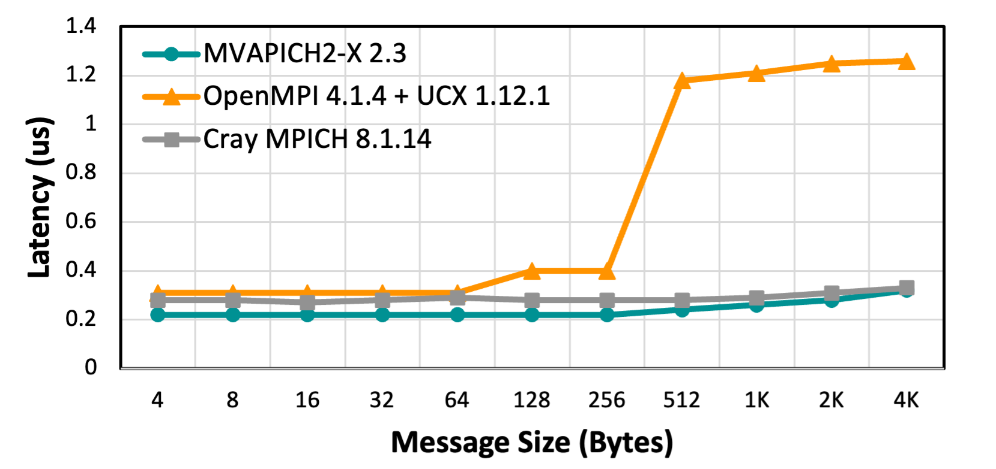
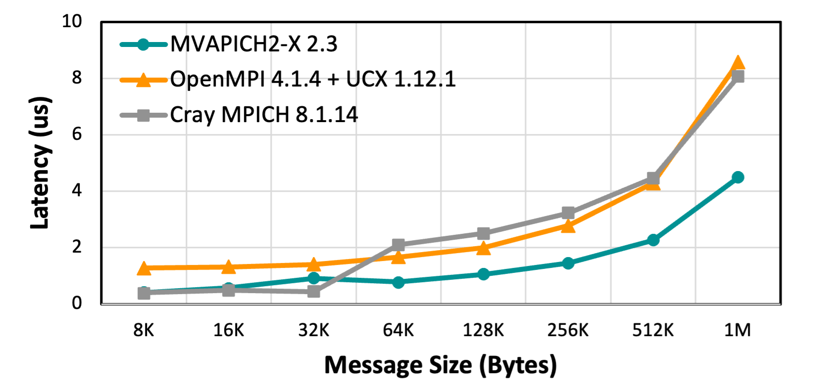
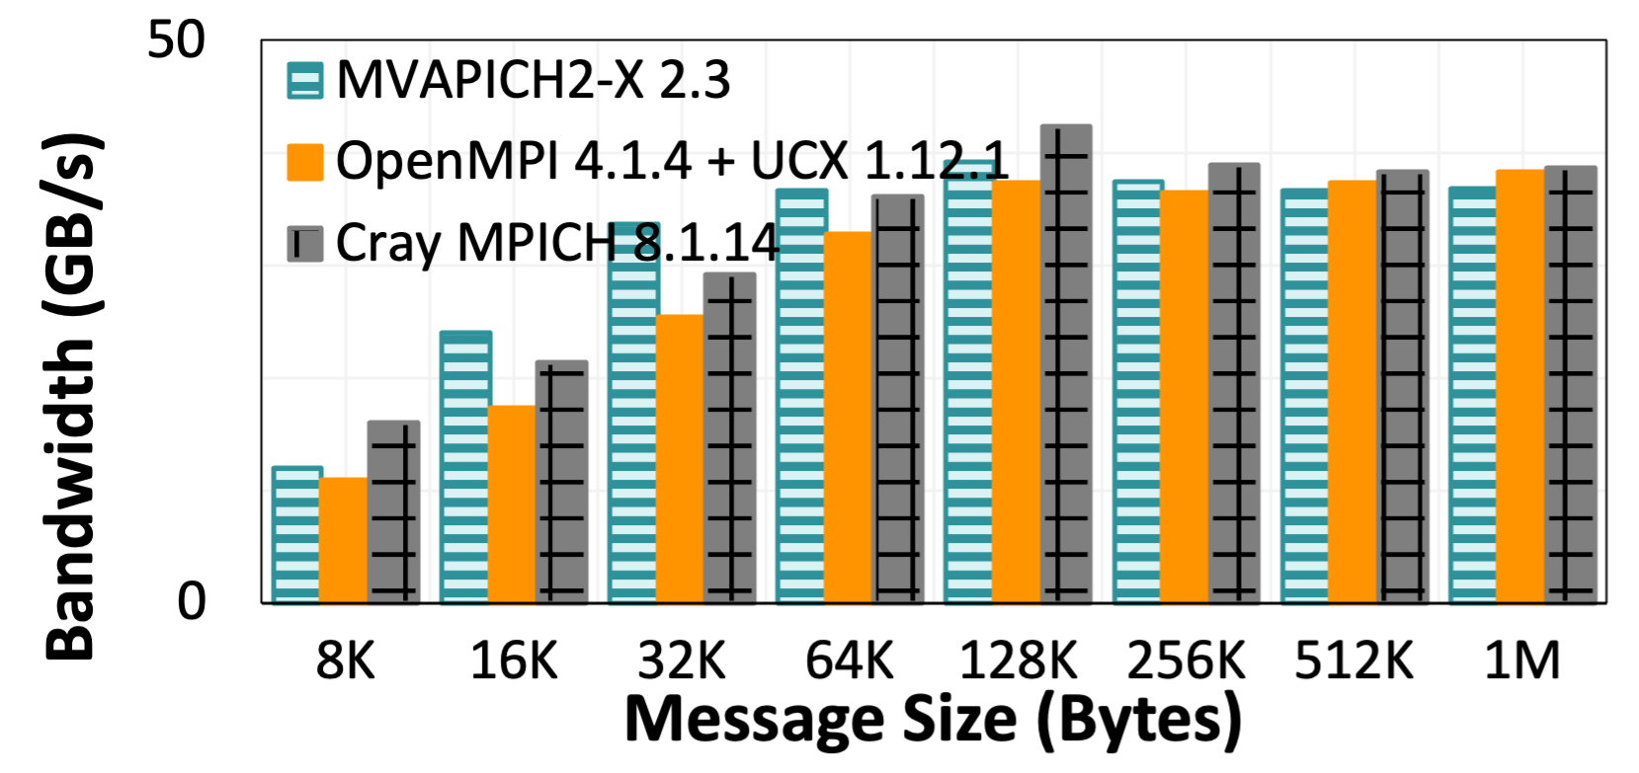
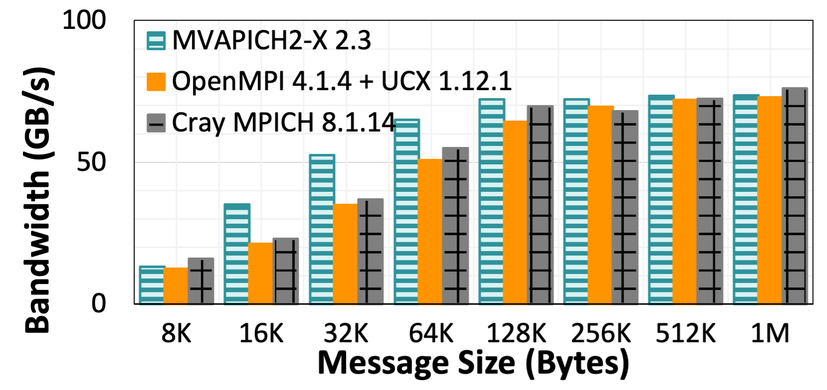
Point-to-Point Performance - Intra-Node CPU
Peak Bandwidth:
MVAPICH2-X 39.2 GB/s
OpenMPI+UCX 38.2GB/s
CrayMPICH 42 GB/s
Latency at 4 Bytes:
MVAPICH2-X 0.22 us
OpenMPI+UCX 0.31 us
CrayMPICH 0.27 us
Latency (small messages)
Latency (large messages)
Bandwidth
Bi-Directional Bandwidth
AMD Epyc Rome CPUs on Spock System
Reference: High Performance MPI over the Slingshot Interconnect: Early Experiences K. Khorassani, C. Chen, B. Ramesh, A. Shafi, H. Subramoni, D. Panda Practice and Experience in Advanced Research Computing, Jul 2022.

Slide 17
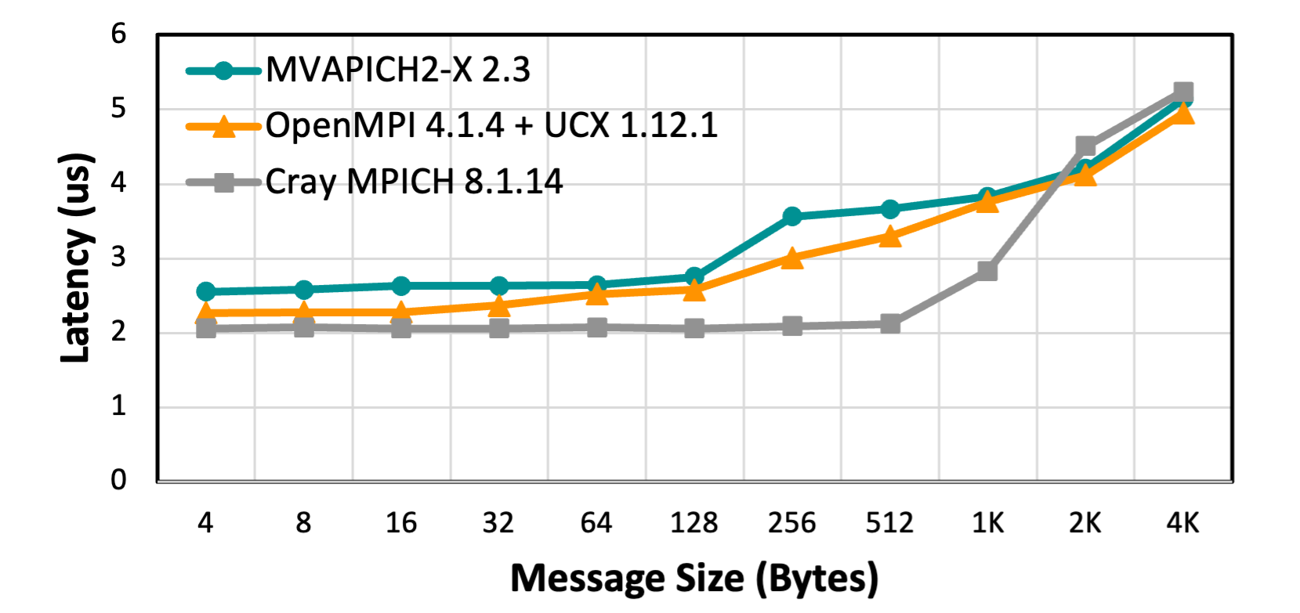
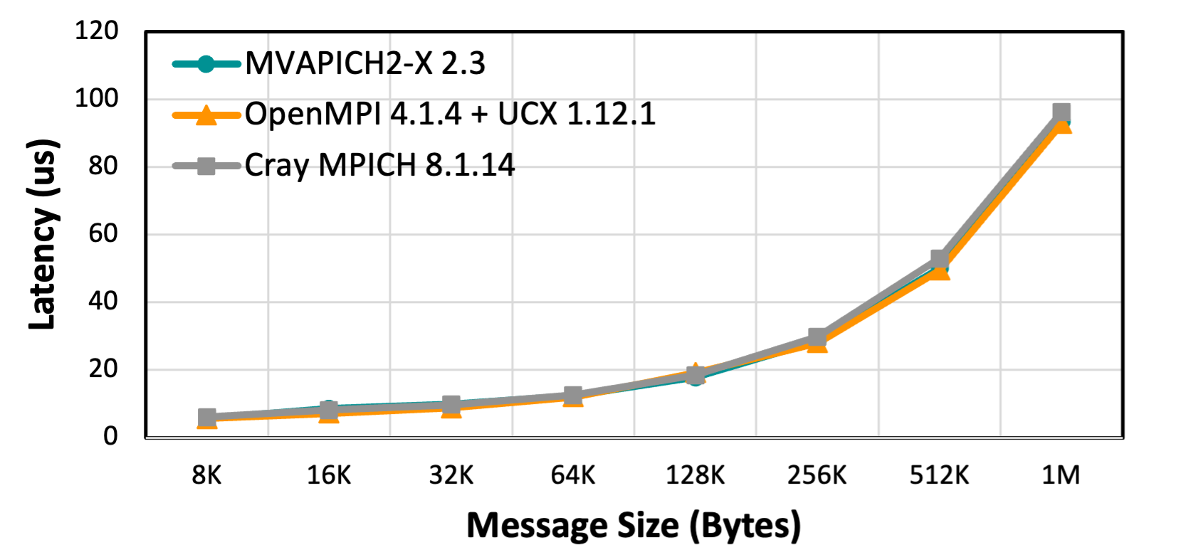
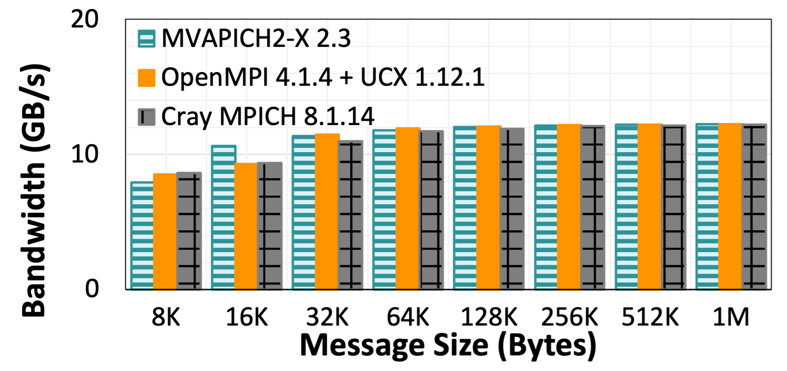
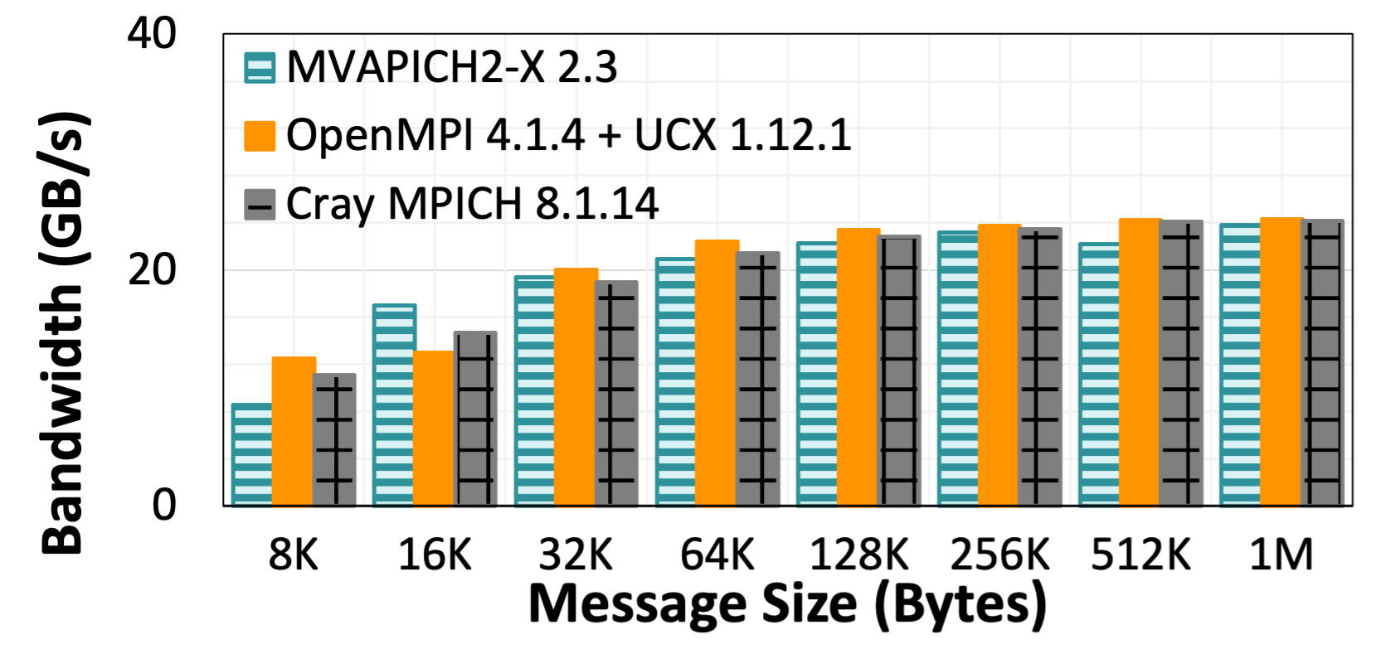
Point-to-Point Performance - Inter-Node CPU
Slingshot-10 Interconnect for over network communication (12.5+12.5 GB/s)
Peak Bandwidth:
MVAPICH2-X 122.4 MB/s
OpenMPI+UCX 122.4 MB/s
CrayMPICH 122.4 MB/s
Latency at 4 Bytes:
MVAPICH2-X 2.55 us
OpenMPI+UCX 2.27 us
CrayMPICH 2.07 us
Latency (small messages)
Latency (large messages)
Bandwidth
Bi-Directional Bandwidth
AMD Epyc Rome CPUs on Spock System
Reference: High Performance MPI over the Slingshot Interconnect: Early Experiences K. Khorassani, C. Chen, B. Ramesh, A. Shafi, H. Subramoni, D. Panda Practice and Experience in Advanced Research Computing, Jul 2022.

Slide 18
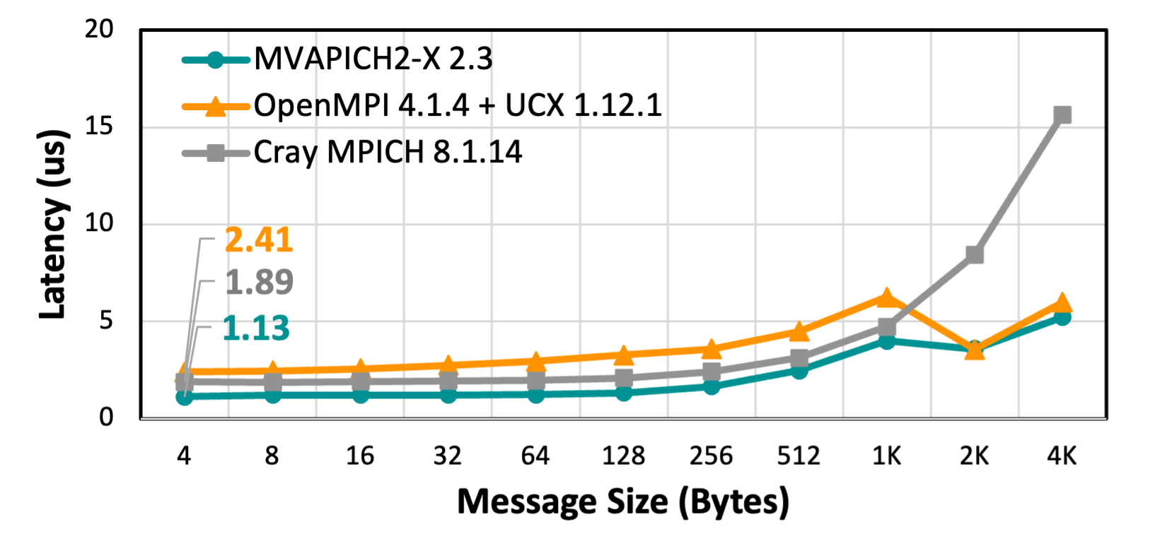
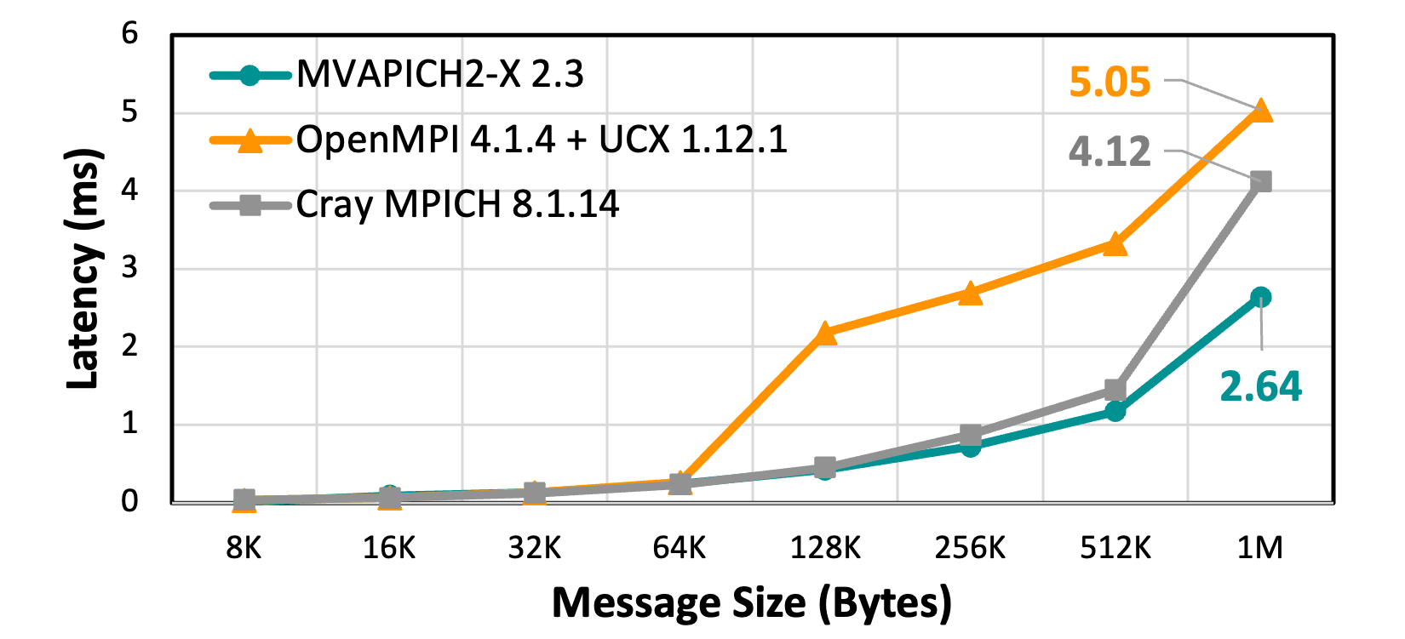
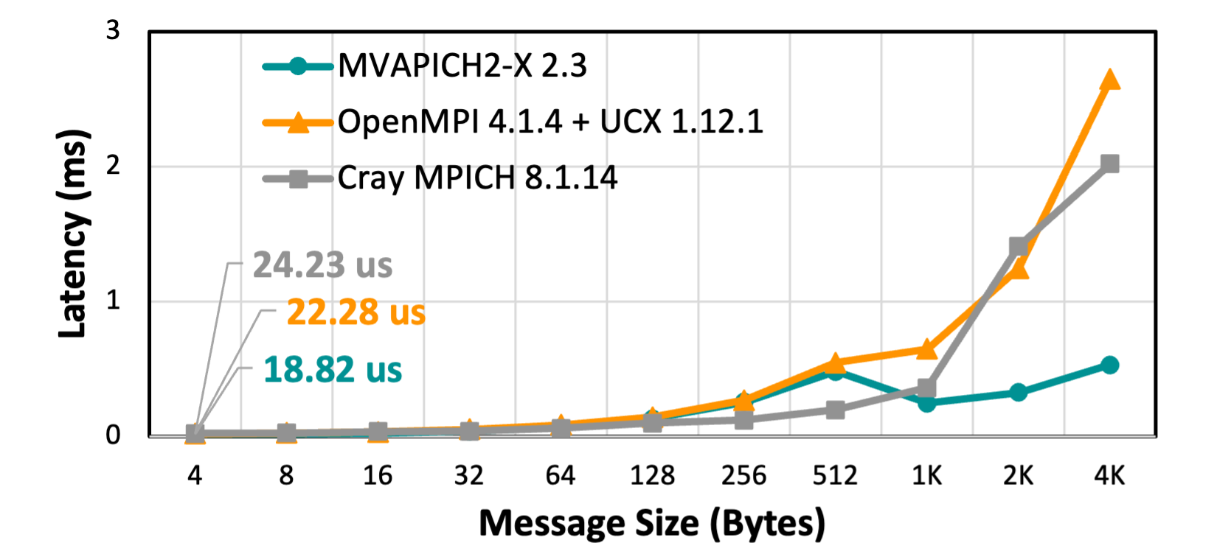
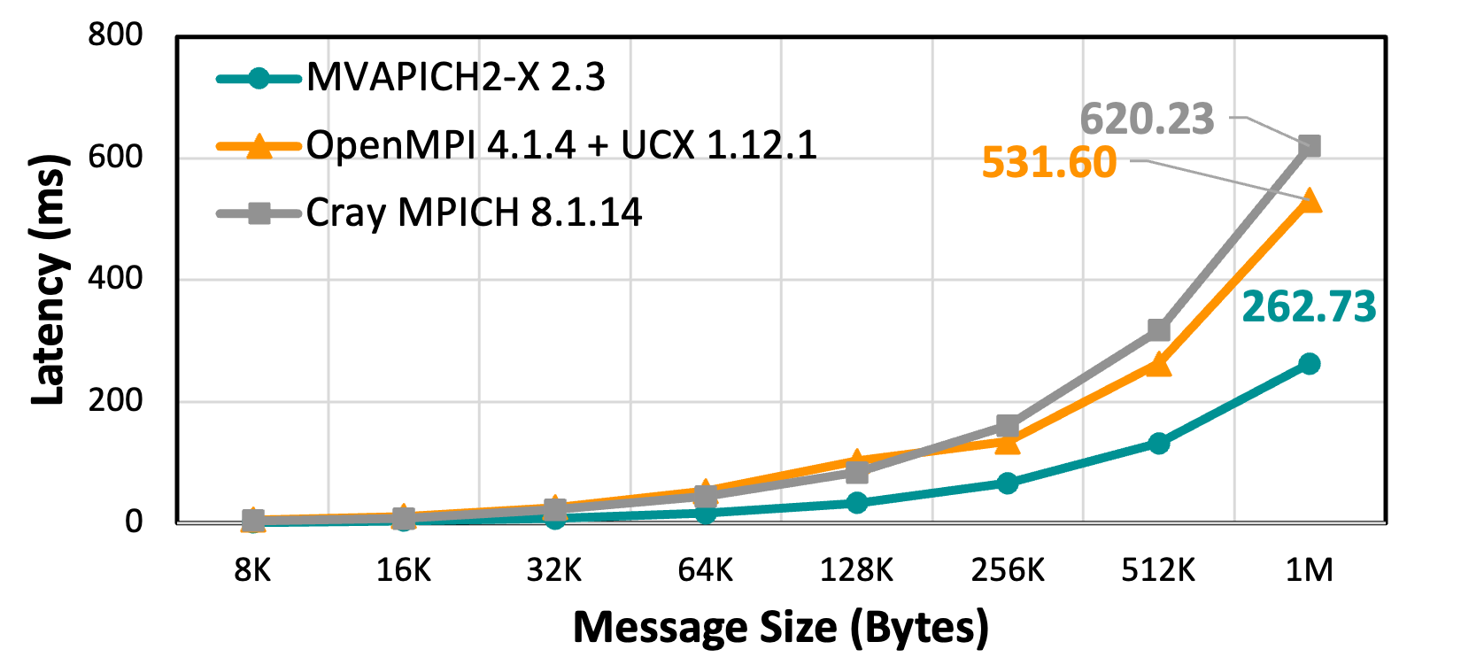
Collectives Performance - CPU
GATHER
ALLGATHER
Gather (small messages)
Gather (large messages)
Allgather (small messages)
Allgather (large messages)
256 CPUs – 4 Nodes & 64 PPN on Spock System
Reference: High Performance MPI over the Slingshot Interconnect: Early Experiences K. Khorassani, C. Chen, B. Ramesh, A. Shafi, H. Subramoni, D. Panda Practice and Experience in Advanced Research Computing, Jul 2022.

Slide 19
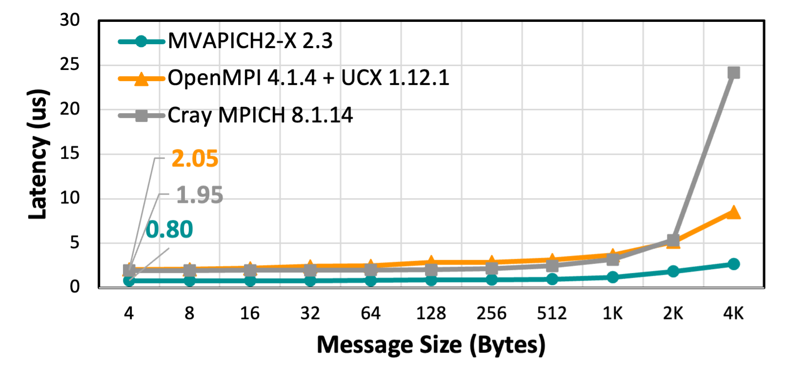
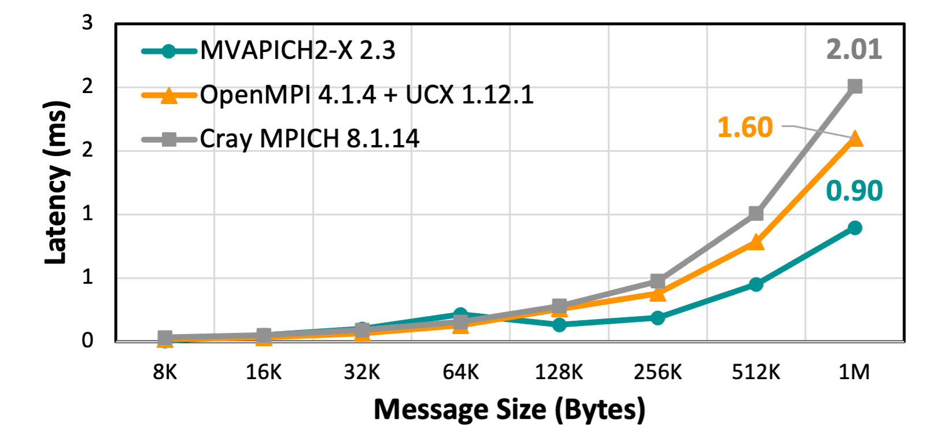
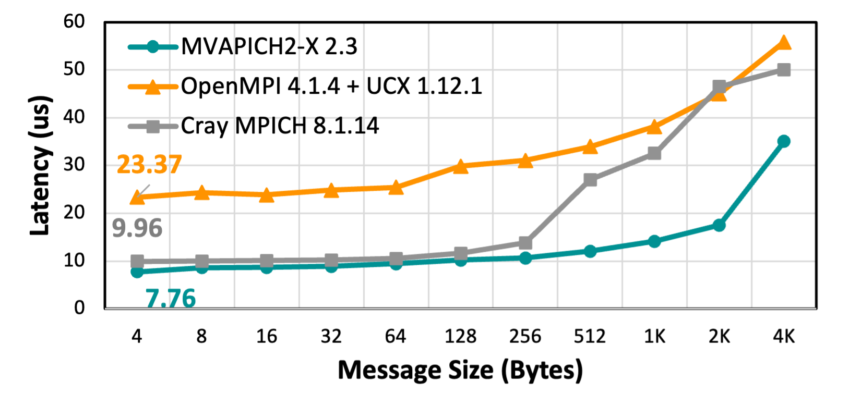
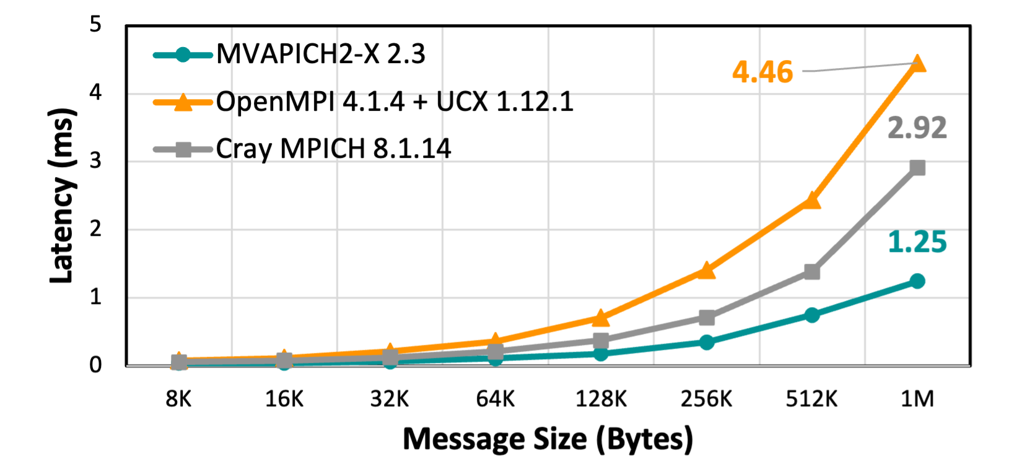
Collectives Performance - CPU
REDUCE
ALLREDUCE
Reduce (small messages)
Reduce (large messages)
Allreduce (small messages)
Allreduce (large messages)
256 CPUs – 4 Nodes & 64 PPN on Spock System
Reference: High Performance MPI over the Slingshot Interconnect: Early Experiences K. Khorassani, C. Chen, B. Ramesh, A. Shafi, H. Subramoni, D. Panda Practice and Experience in Advanced Research Computing, Jul 2022.

Slide 20
Performance Evaluation
GPU

Slide 21


GPU-Aware (CUDA/ROCm) MPI Library: MVAPICH-GPU
Standard MPI interfaces used for unified data movement
Takes advantage of Unified Virtual Addressing (>= CUDA 4.0)
Overlaps data movement from GPU with RDMA transfers
At Sender:
At Receiver:
MPI_Recv(r_devbuf, size, …);
MPI_Send(s_devbuf, size, …);
inside
MVAPICH2
High Performance and High Productivity

Slide 22
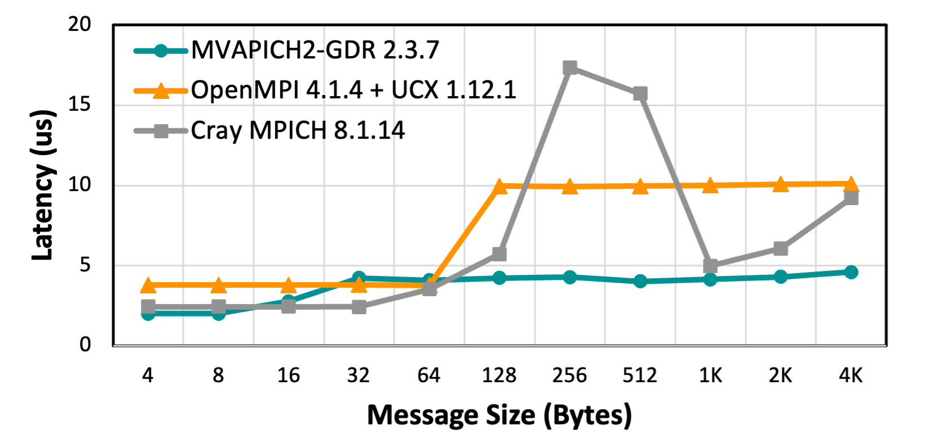
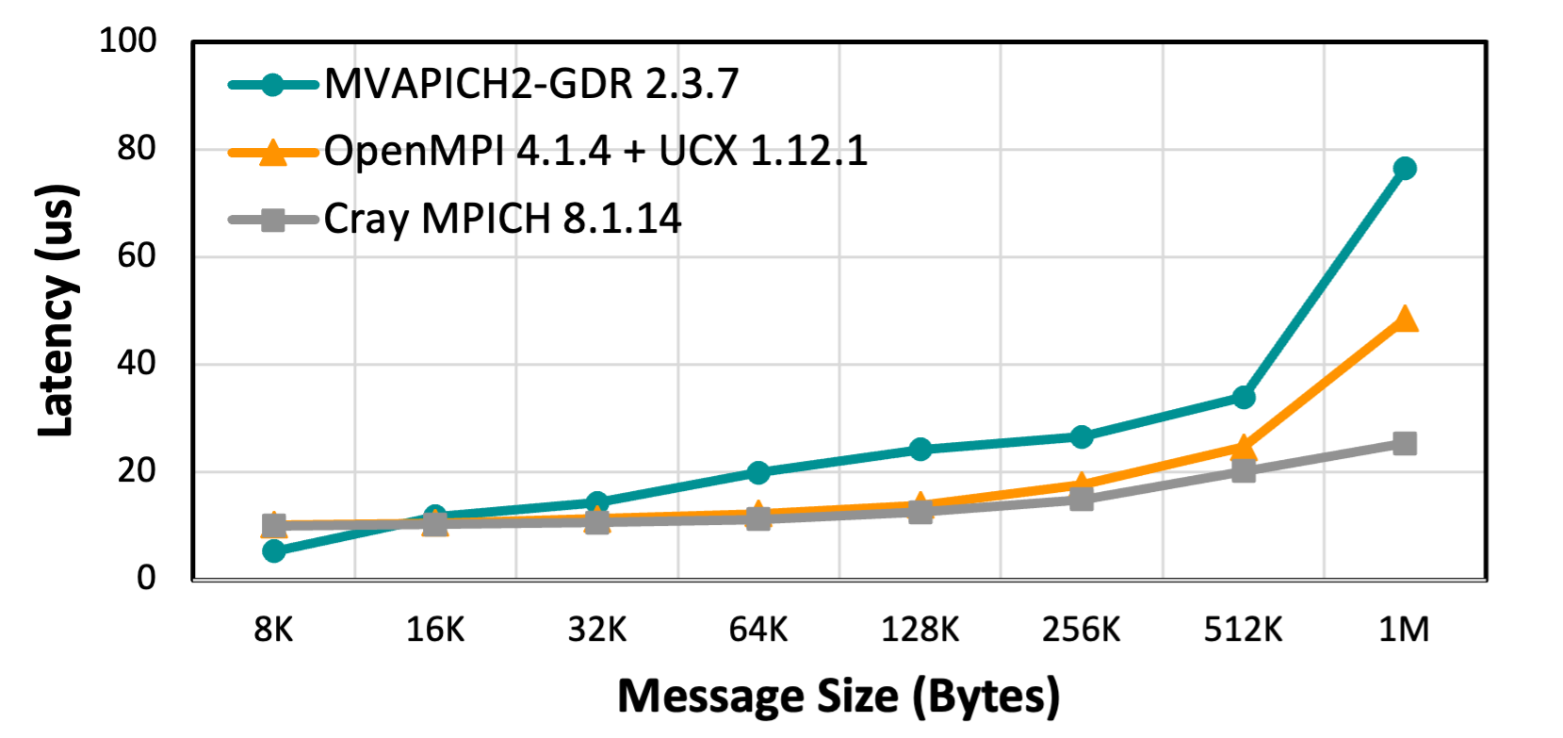
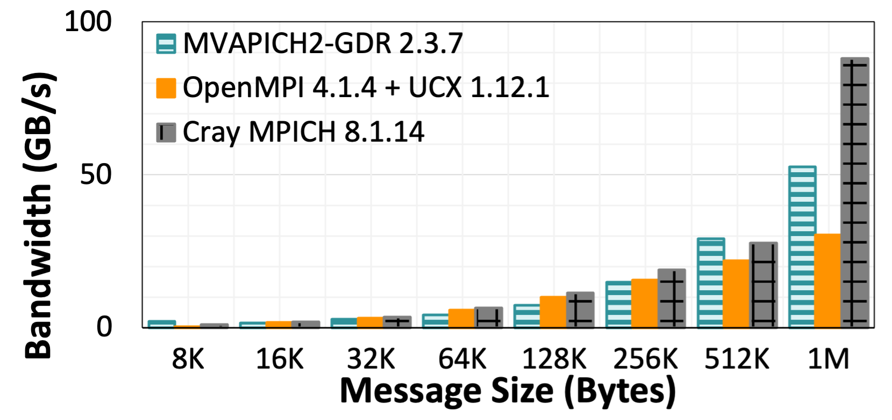
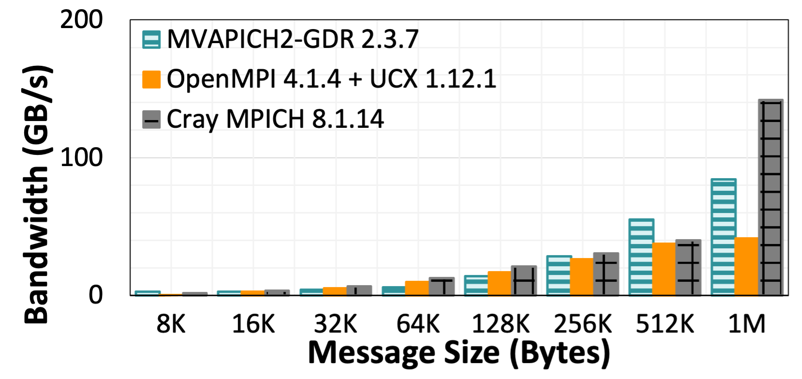
Point-to-Point Performance - Intra-Node GPU
All GPUs connected by Infinity Fabric (46+46GB/s)
PCI Bar Mapped Memory for small message sizes.
ROCm Inter-Process Communication (IPC) used in med-large message range.
Peak Bandwidth:
MVAPICH2-GDR 52.5 GB/s
OpenMPI+UCX 30.2 GB/s
CrayMPICH 88 GB/s
Latency at 4 Bytes:
MVAPICH2-GDR 2.01 us
OpenMPI+UCX 3.79 us
CrayMPICH 2.44 us
Latency (small messages)
Latency (large messages)
Bandwidth
Bi-Directional Bandwidth
MI100 GPUs on Spock System
Reference: High Performance MPI over the Slingshot Interconnect: Early Experiences K. Khorassani, C. Chen, B. Ramesh, A. Shafi, H. Subramoni, D. Panda Practice and Experience in Advanced Research Computing, Jul 2022.

Slide 23
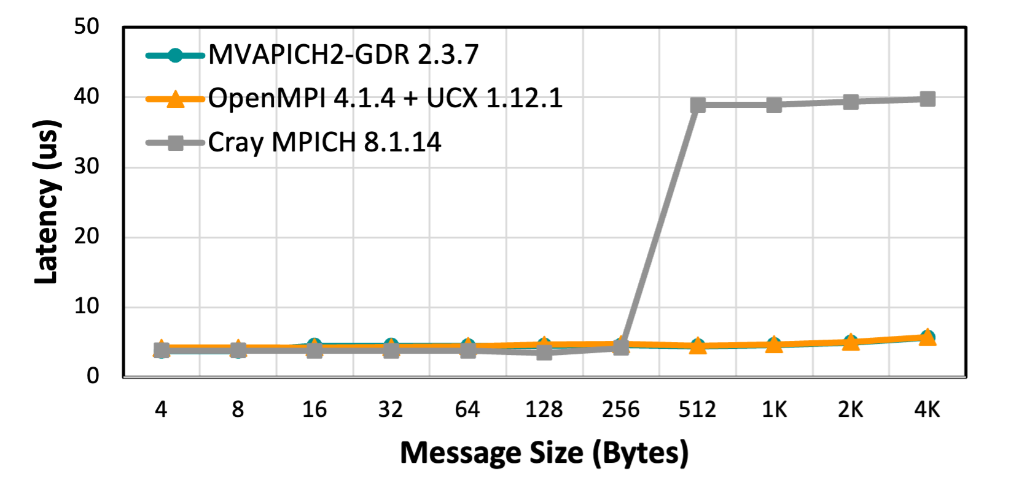
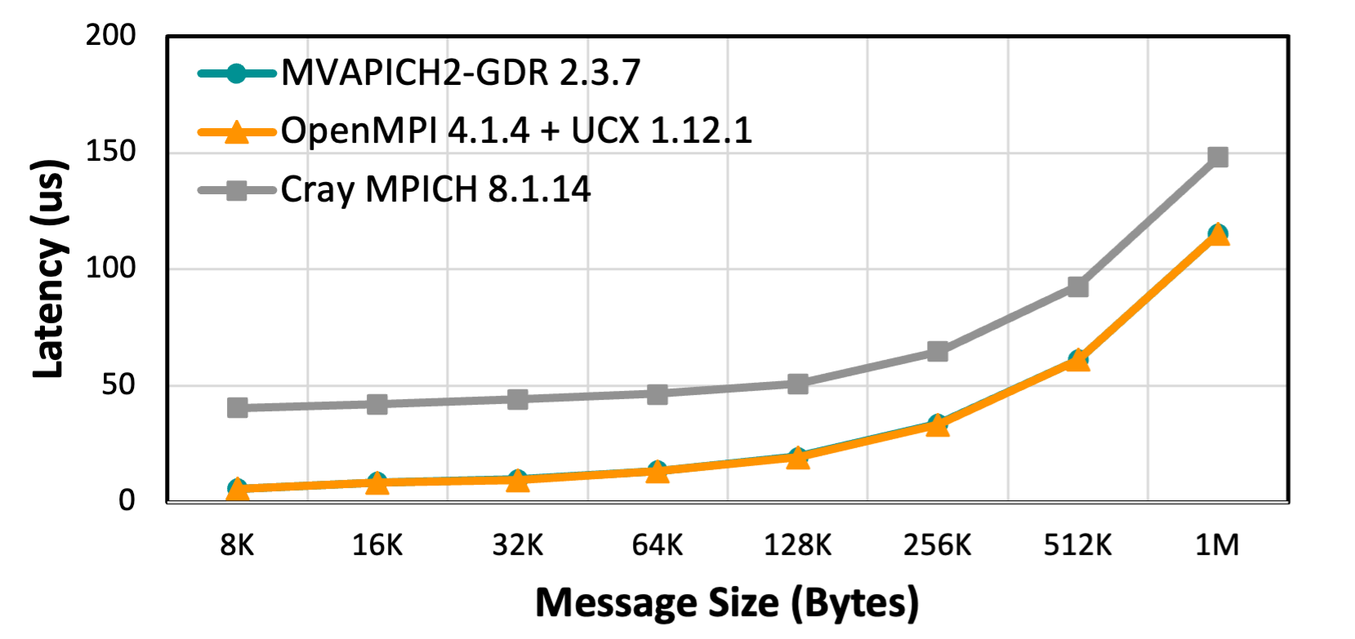
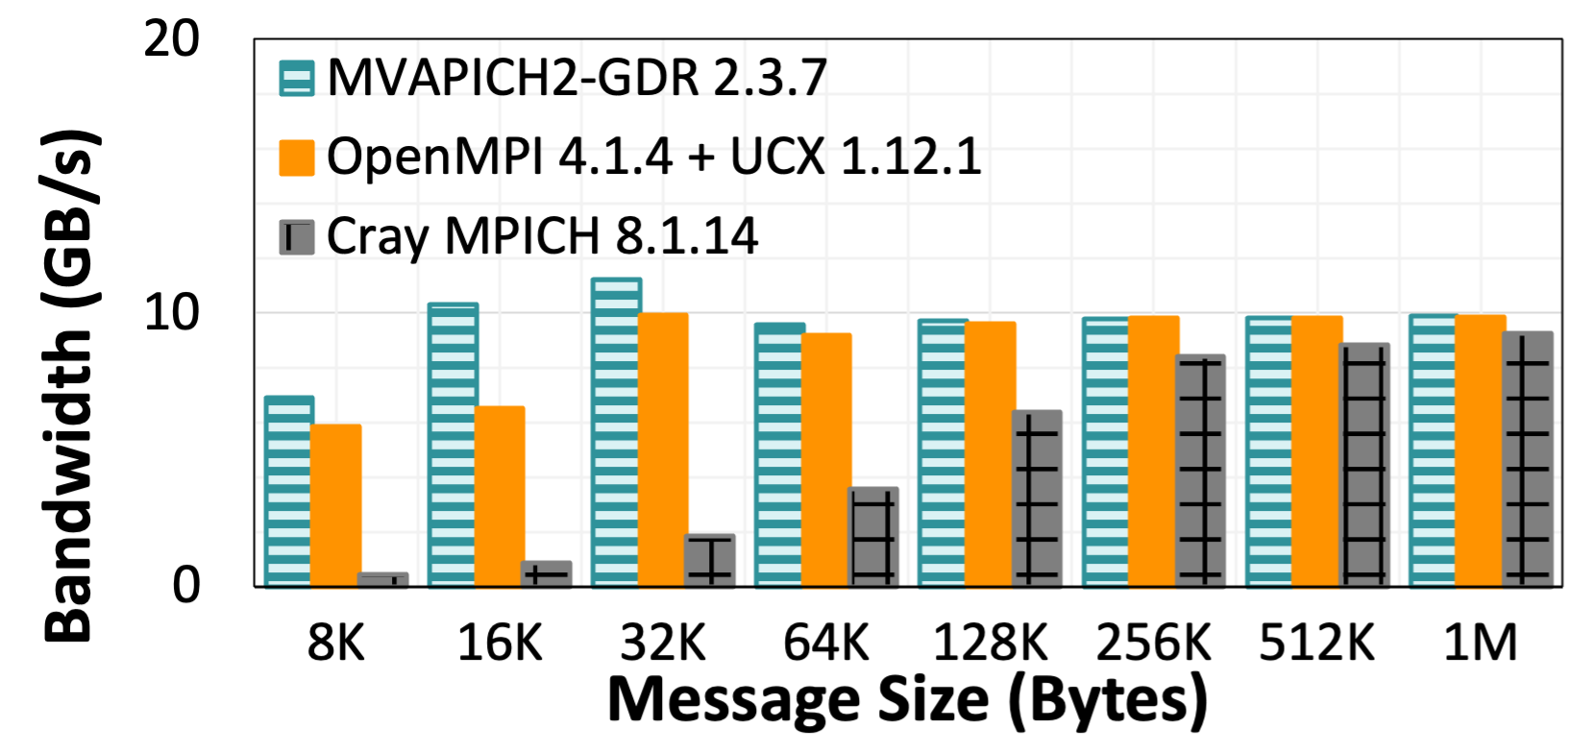
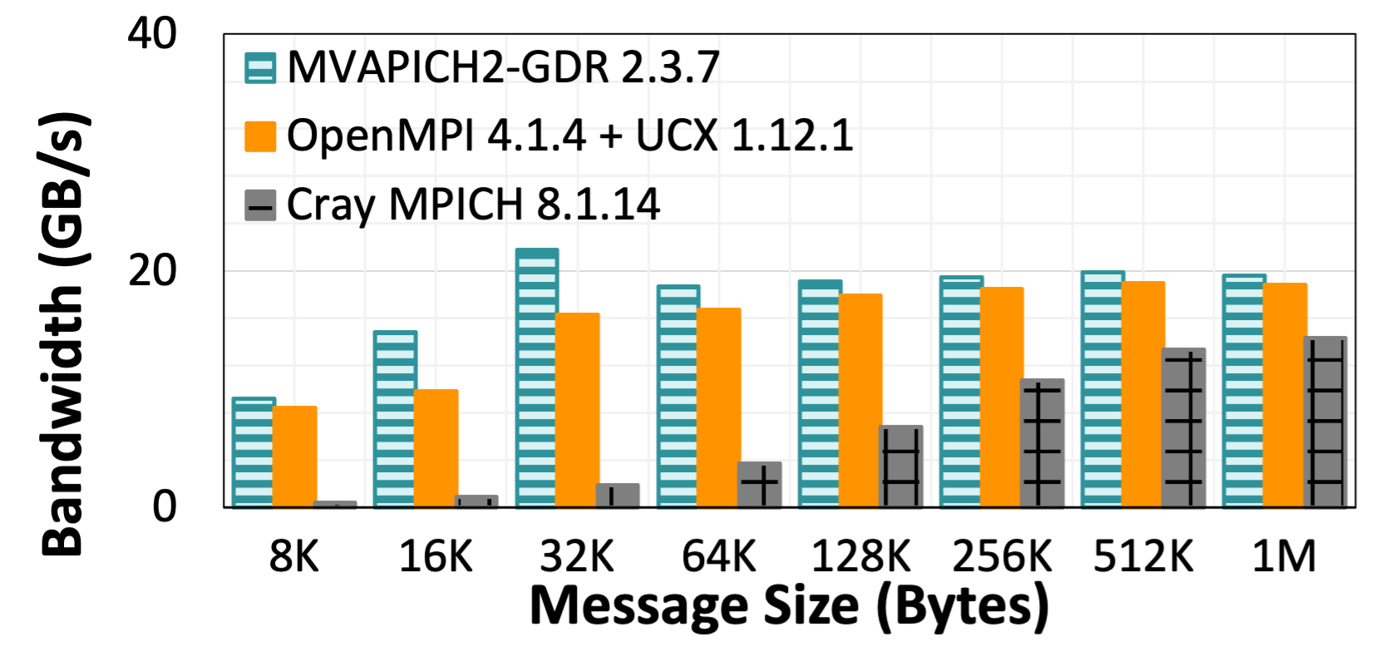
Point-to-Point Performance - Inter-Node GPU
Slingshot-10 Interconnect for over network communication (12.5+12.5 GB/s)
Peak Bandwidth:
MVAPICH2-GDR 9.9 GB/s
OpenMPI+UCX 9.8 GB/s
CrayMPICH 9.2 GB/s
Latency at 4 Bytes:
MVAPICH2-GDR 3.73 us
OpenMPI+UCX 4.23 us
CrayMPICH 3.8 us
Latency (small messages)
Latency (large messages)
Bandwidth
Bi-Directional Bandwidth
MI100 GPUs on Spock System
Reference: High Performance MPI over the Slingshot Interconnect: Early Experiences K. Khorassani, C. Chen, B. Ramesh, A. Shafi, H. Subramoni, D. Panda Practice and Experience in Advanced Research Computing, Jul 2022.

Slide 24
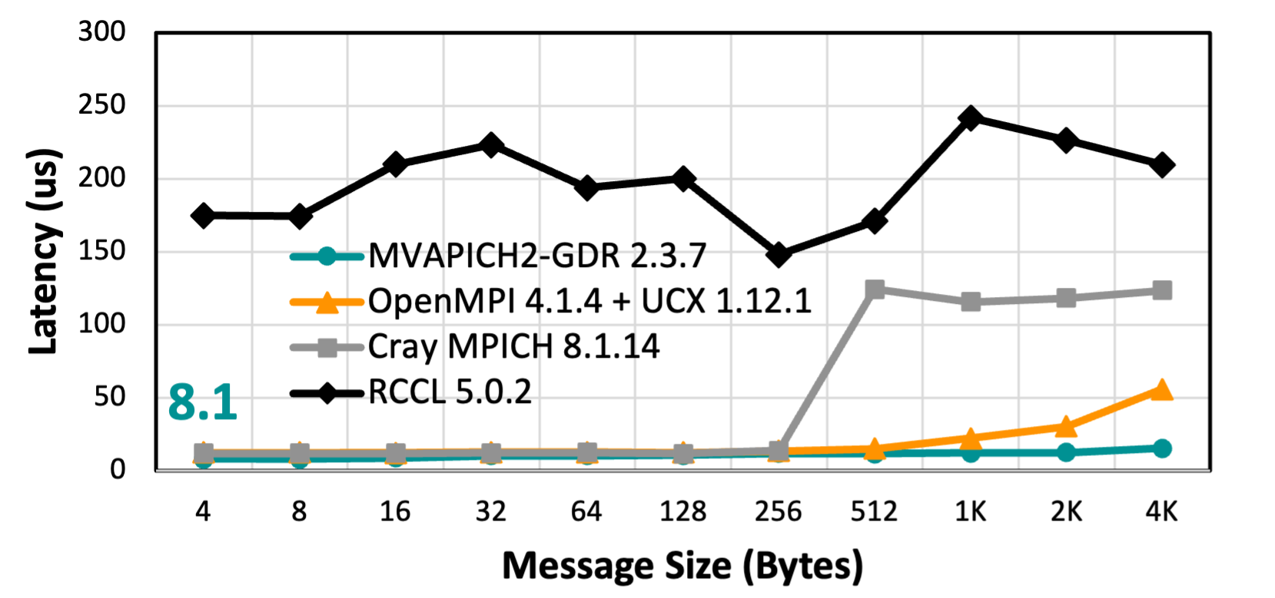
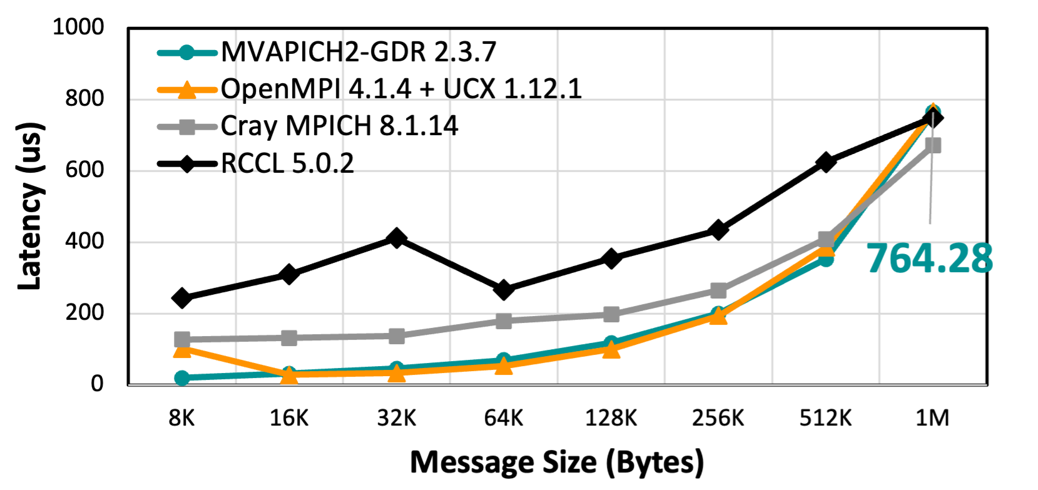
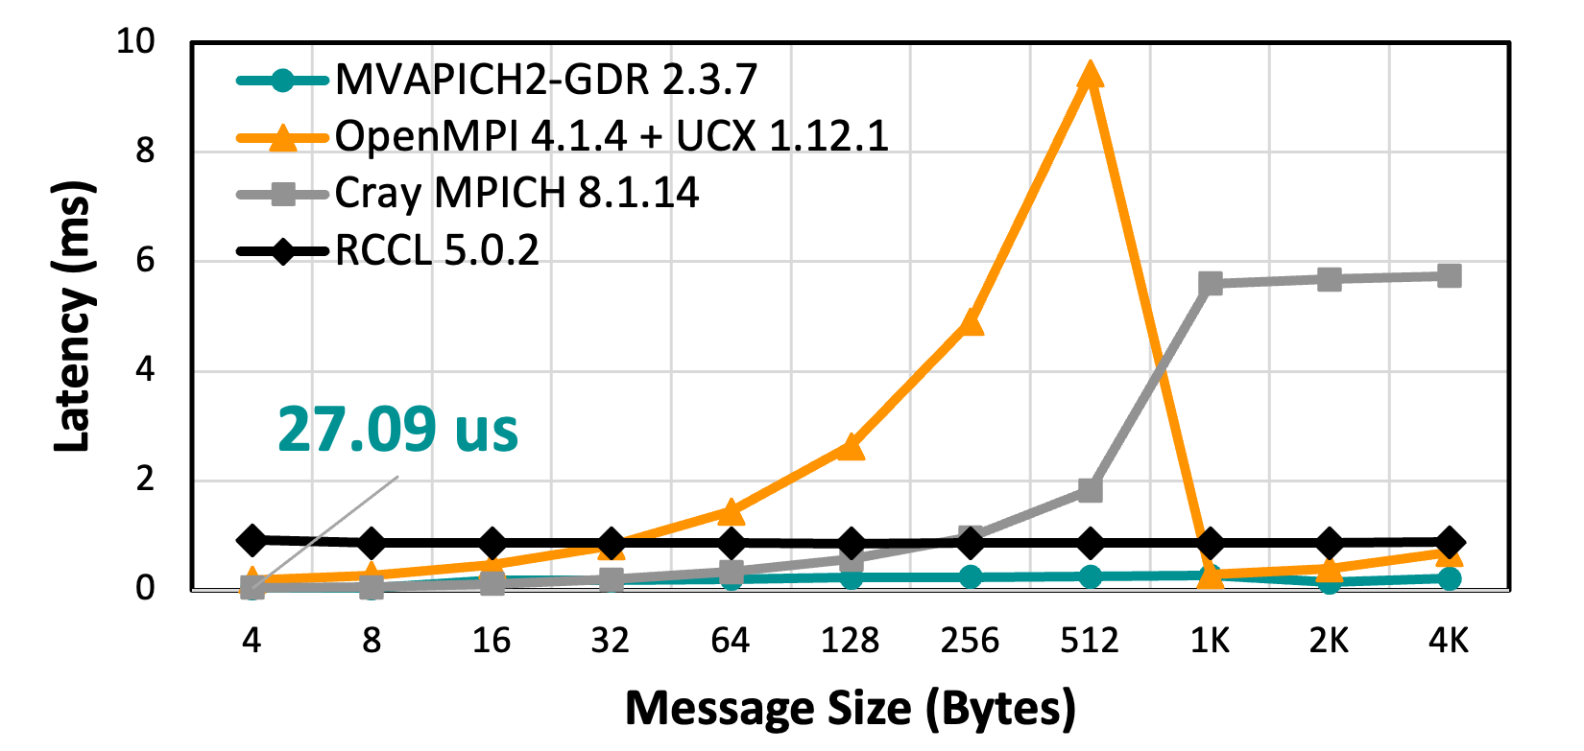
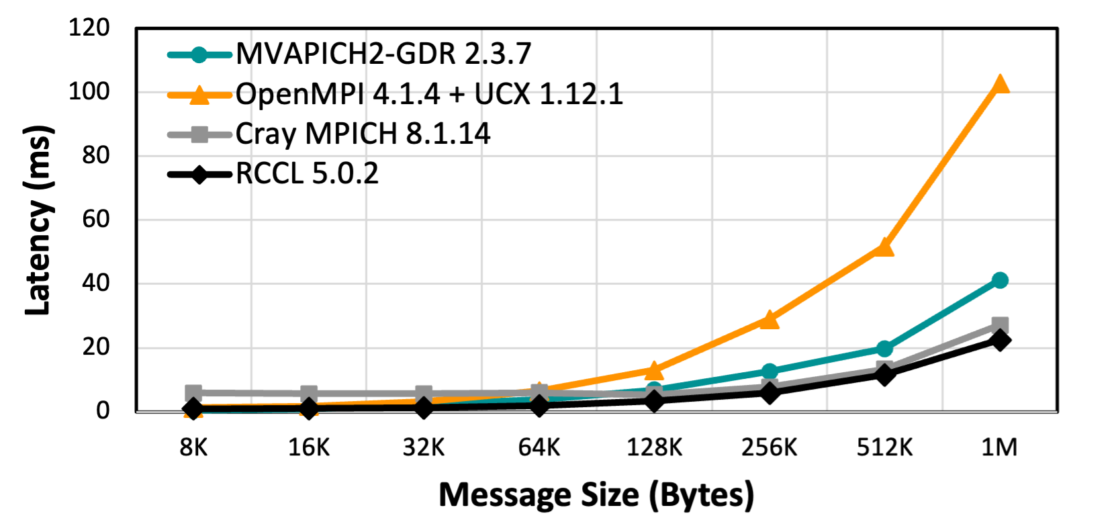
Collectives Performance - GPU
BROADCAST
ALLTOALL
Broadcast (small messages)
Broadcast (large messages)
Alltoall (small messages)
Alltoall (large messages)
64 GPUs – 16 Nodes & 4 GPUs Per Node on Spock System
Reference: High Performance MPI over the Slingshot Interconnect: Early Experiences K. Khorassani, C. Chen, B. Ramesh, A. Shafi, H. Subramoni, D. Panda Practice and Experience in Advanced Research Computing, Jul 2022.

Slide 25
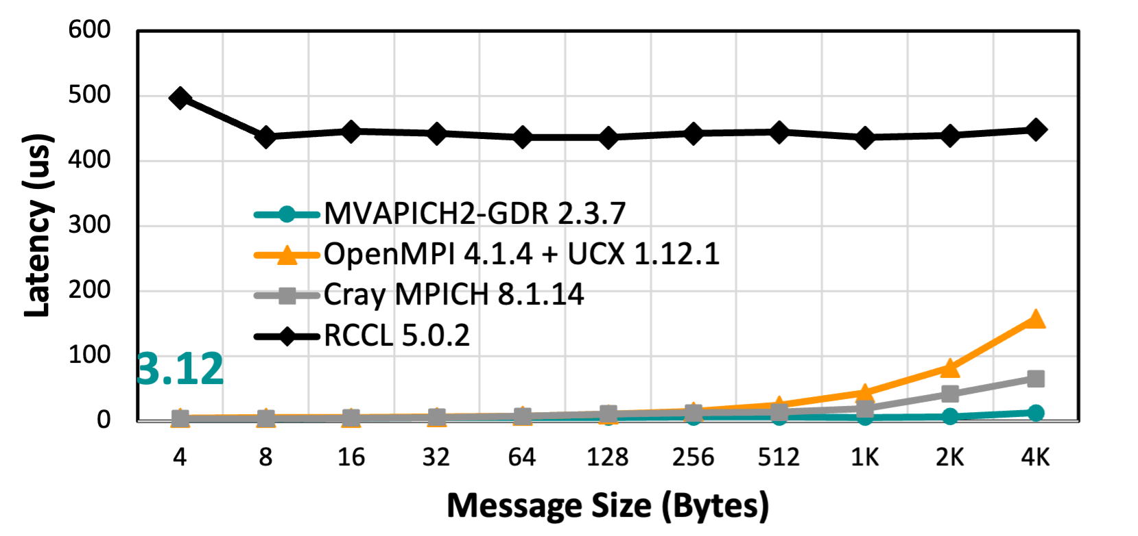
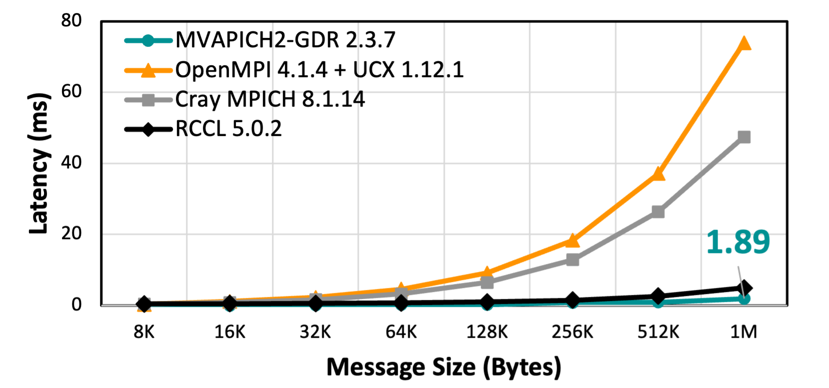
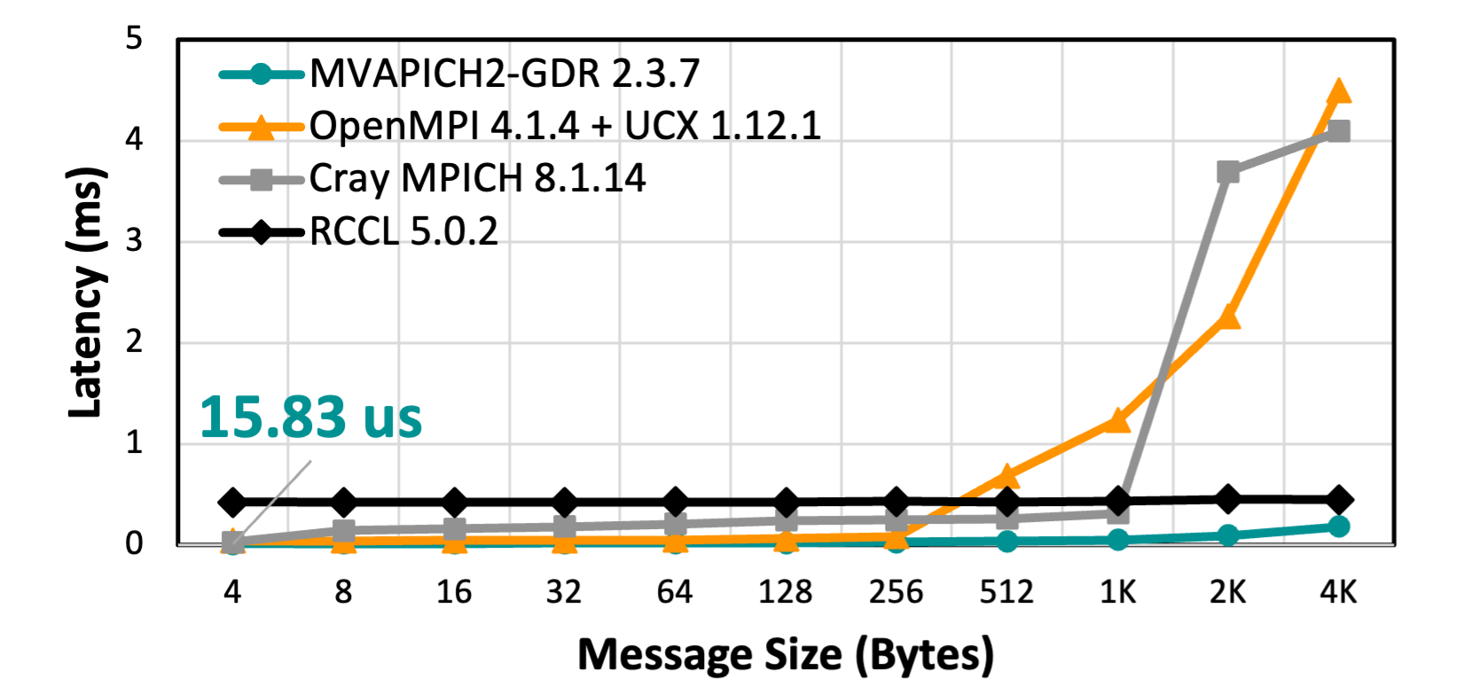
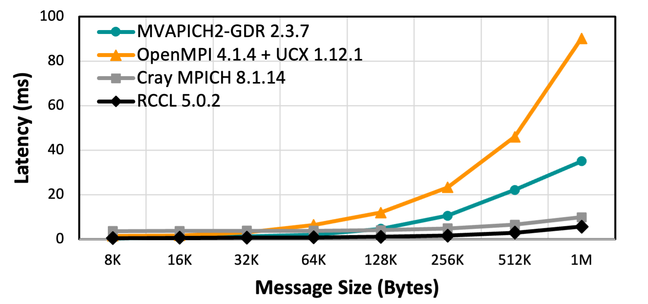
Collectives Performance - GPU
GATHER
ALLGATHER
Gather (small messages)
Gather (large messages)
Allgather (small messages)
Allgather (large messages)
64 GPUs – 16 Nodes & 4 GPUs Per Node on Spock System
Reference: High Performance MPI over the Slingshot Interconnect: Early Experiences K. Khorassani, C. Chen, B. Ramesh, A. Shafi, H. Subramoni, D. Panda Practice and Experience in Advanced Research Computing, Jul 2022.

Slide 26
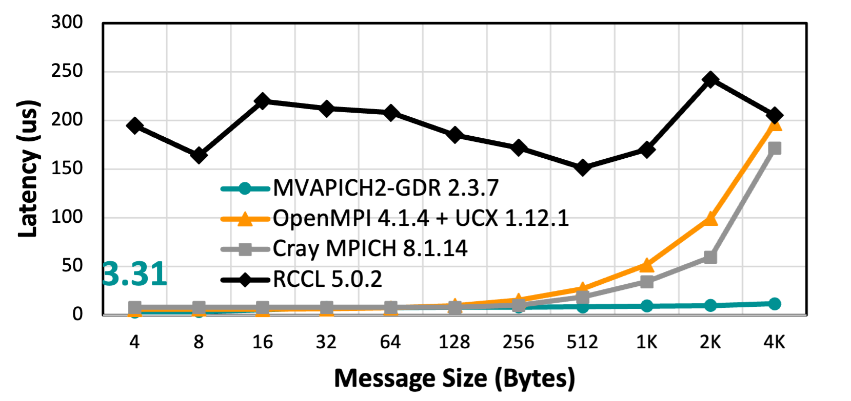
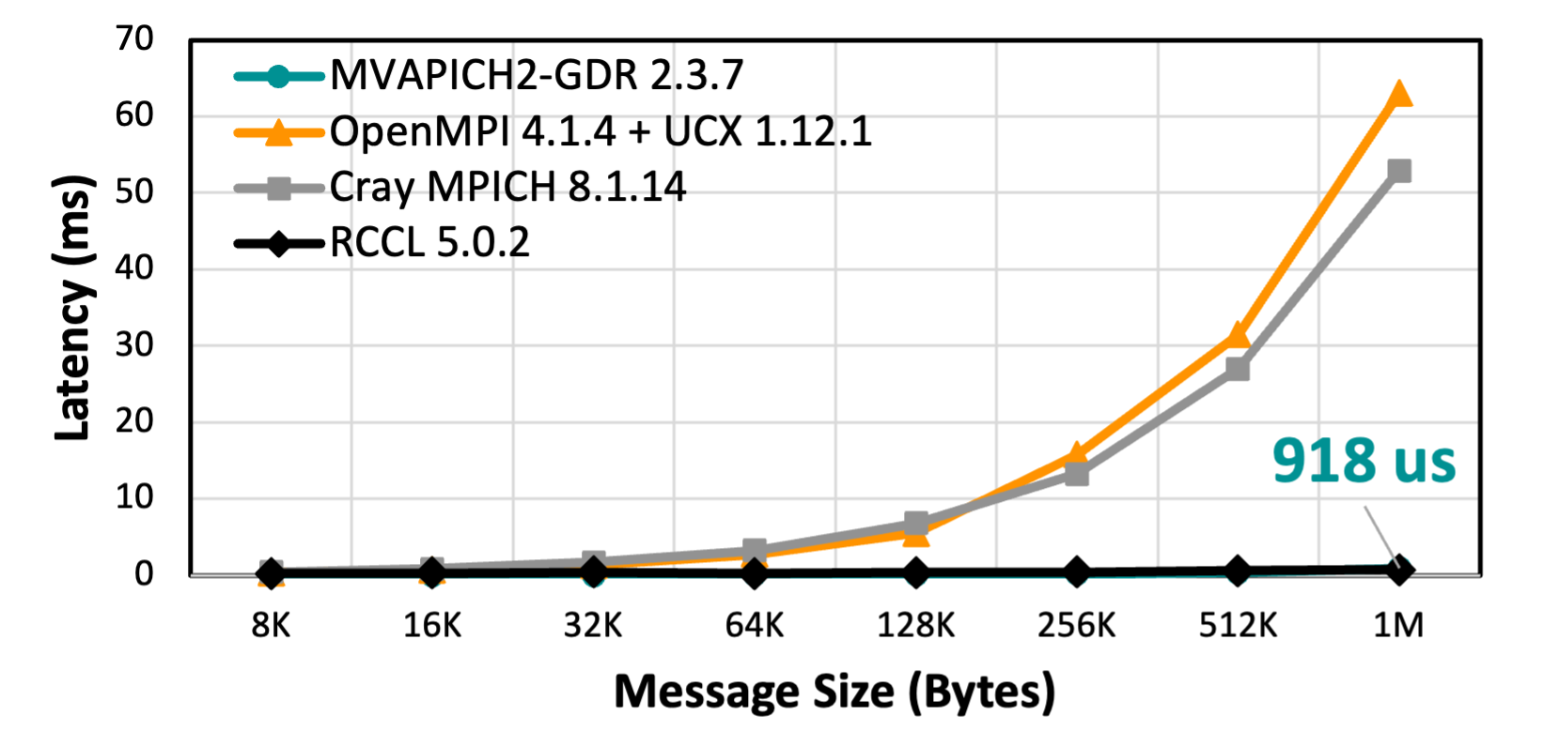
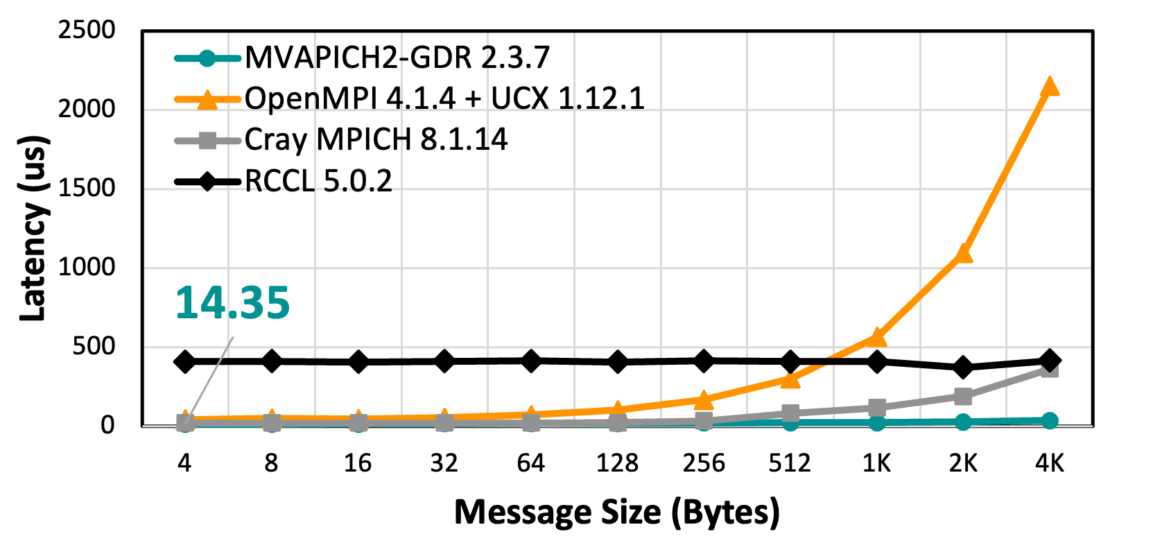
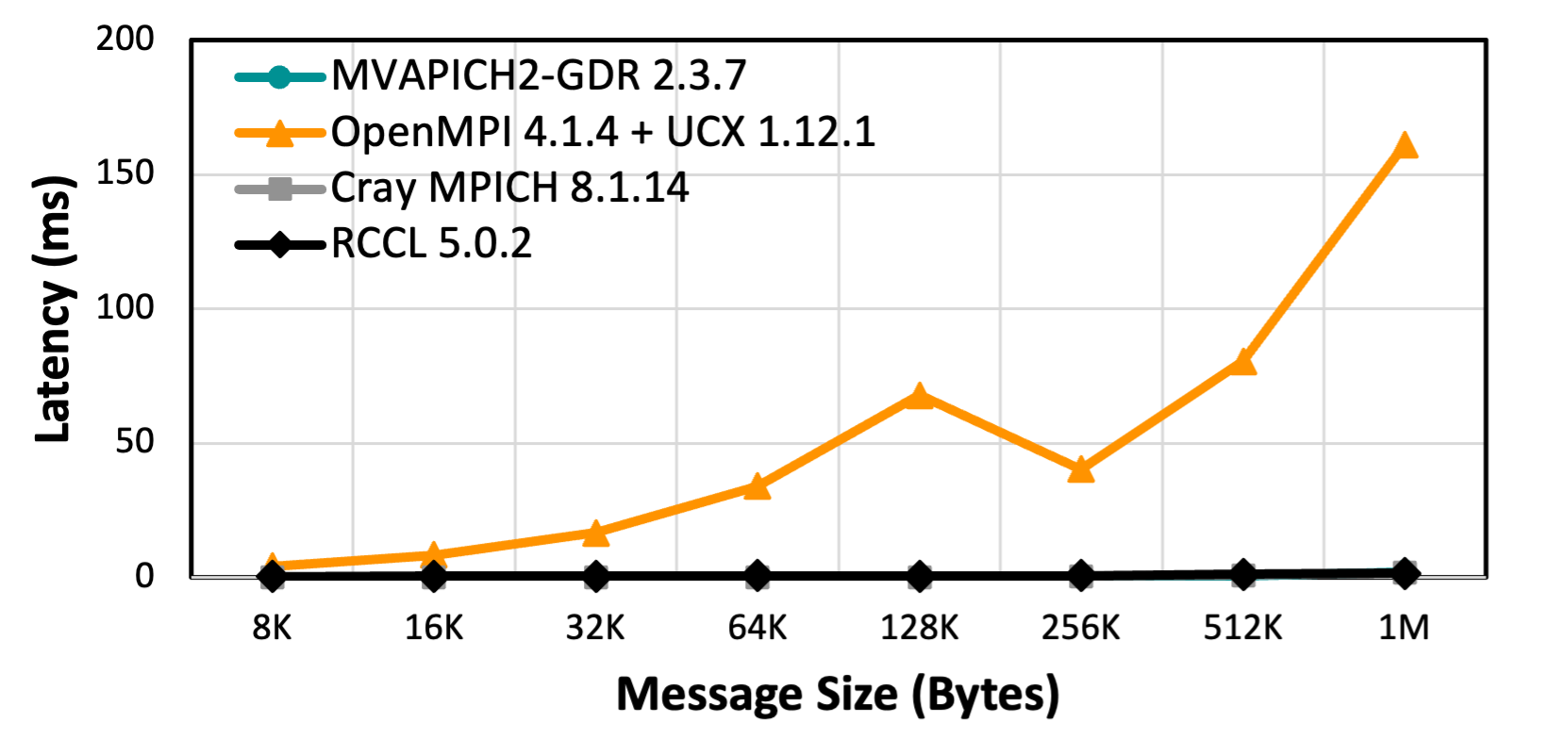
Collectives Performance - GPU
REDUCE
ALLREDUCE
Reduce (small messages)
Reduce (large messages)
Allreduce (small messages)
Allreduce (large messages)
64 GPUs – 16 Nodes & 4 GPUs Per Node on Spock System
Reference: High Performance MPI over the Slingshot Interconnect: Early Experiences K. Khorassani, C. Chen, B. Ramesh, A. Shafi, H. Subramoni, D. Panda Practice and Experience in Advanced Research Computing, Jul 2022.

Slide 27
Performance Evaluation
Slingshot-11
CPU

Slide 28
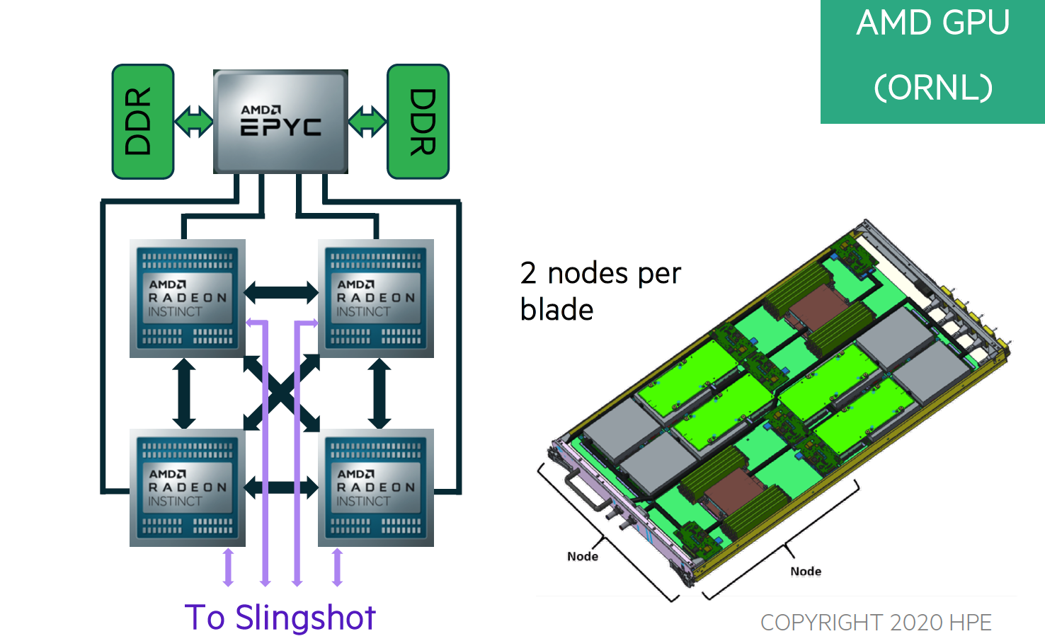
Frontier Compute Node
1 HPC and AI Optimized 3rd Gen AMD EPYC CPU
4 Purpose Built AMD Instinct 250X GPUs
CPU-GPU Interconnect: AMD Infinity Fabric
System Interconnect: Multiple Slingshot NICs providing 100 GB/s network bandwidth.
  Slingshot network which provides adaptive routing, congestion management and quality of service.
Reference: https://www.olcf.ornl.gov/frontier/

Slide 29
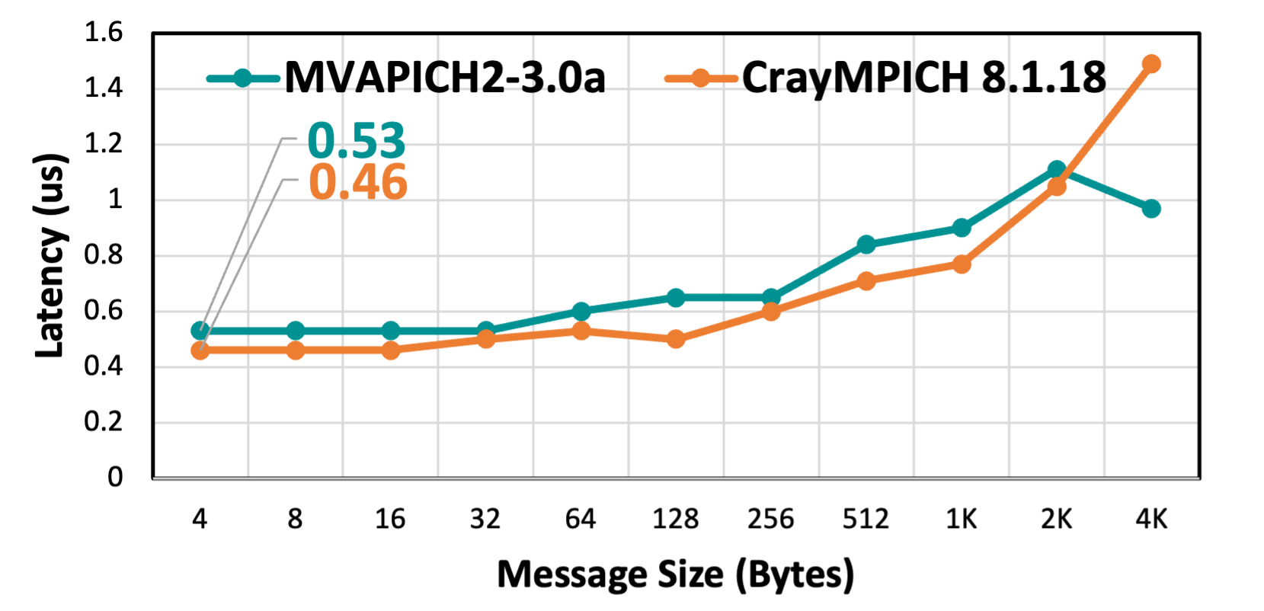
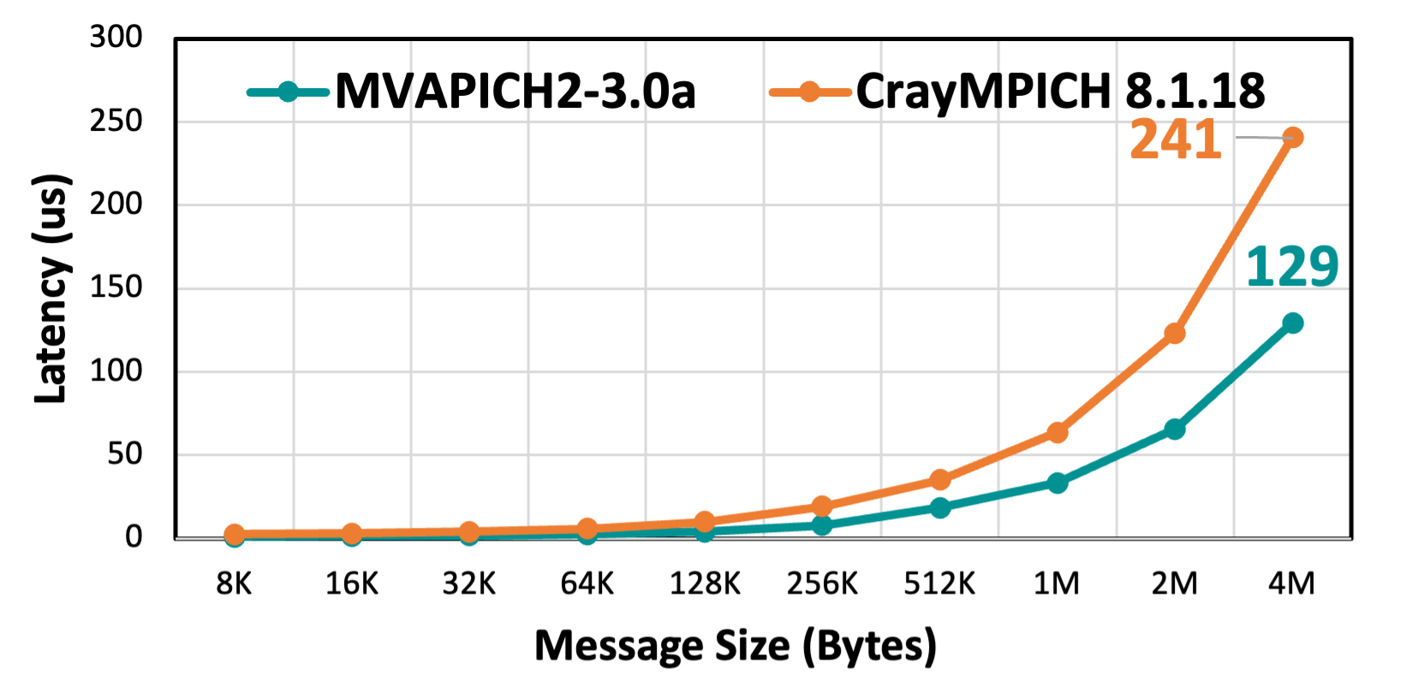
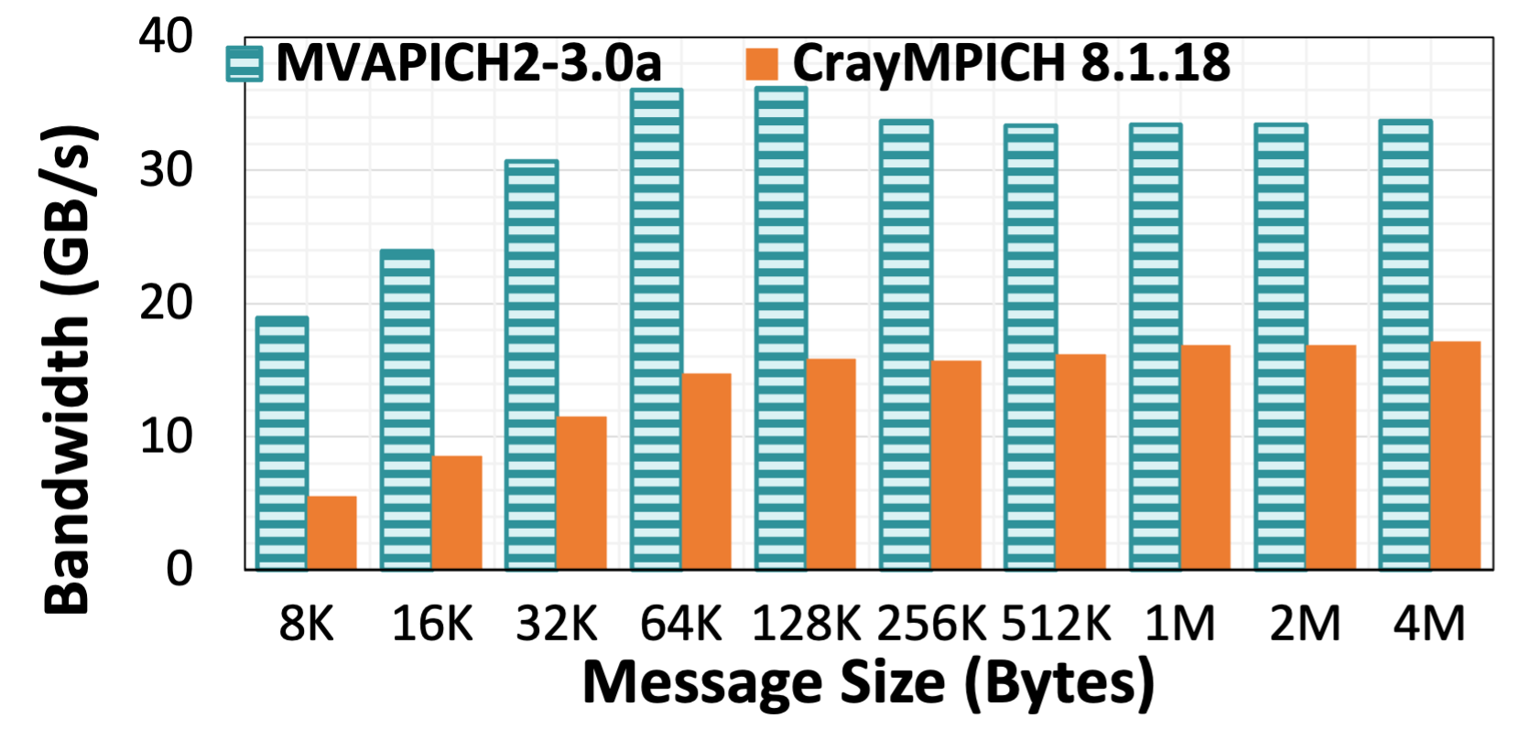
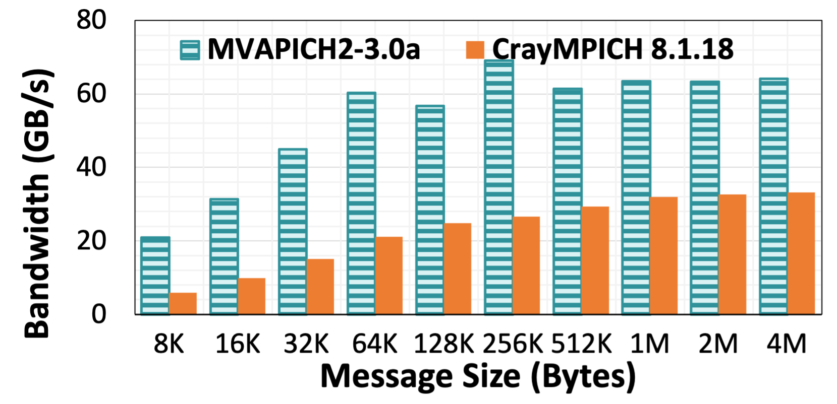
Point-to-Point Performance - Intra-Node CPU
LATENCY
BANDWIDTH
BI-BANDWIDTH
System with Slingshot-11 Networking

Slide 30
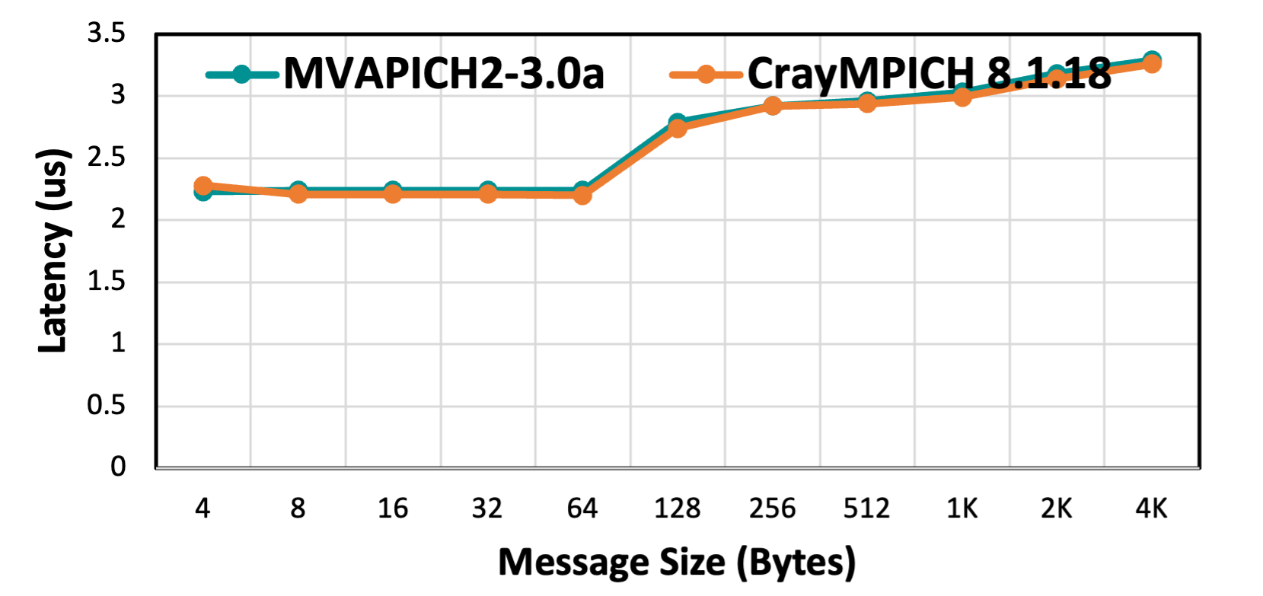
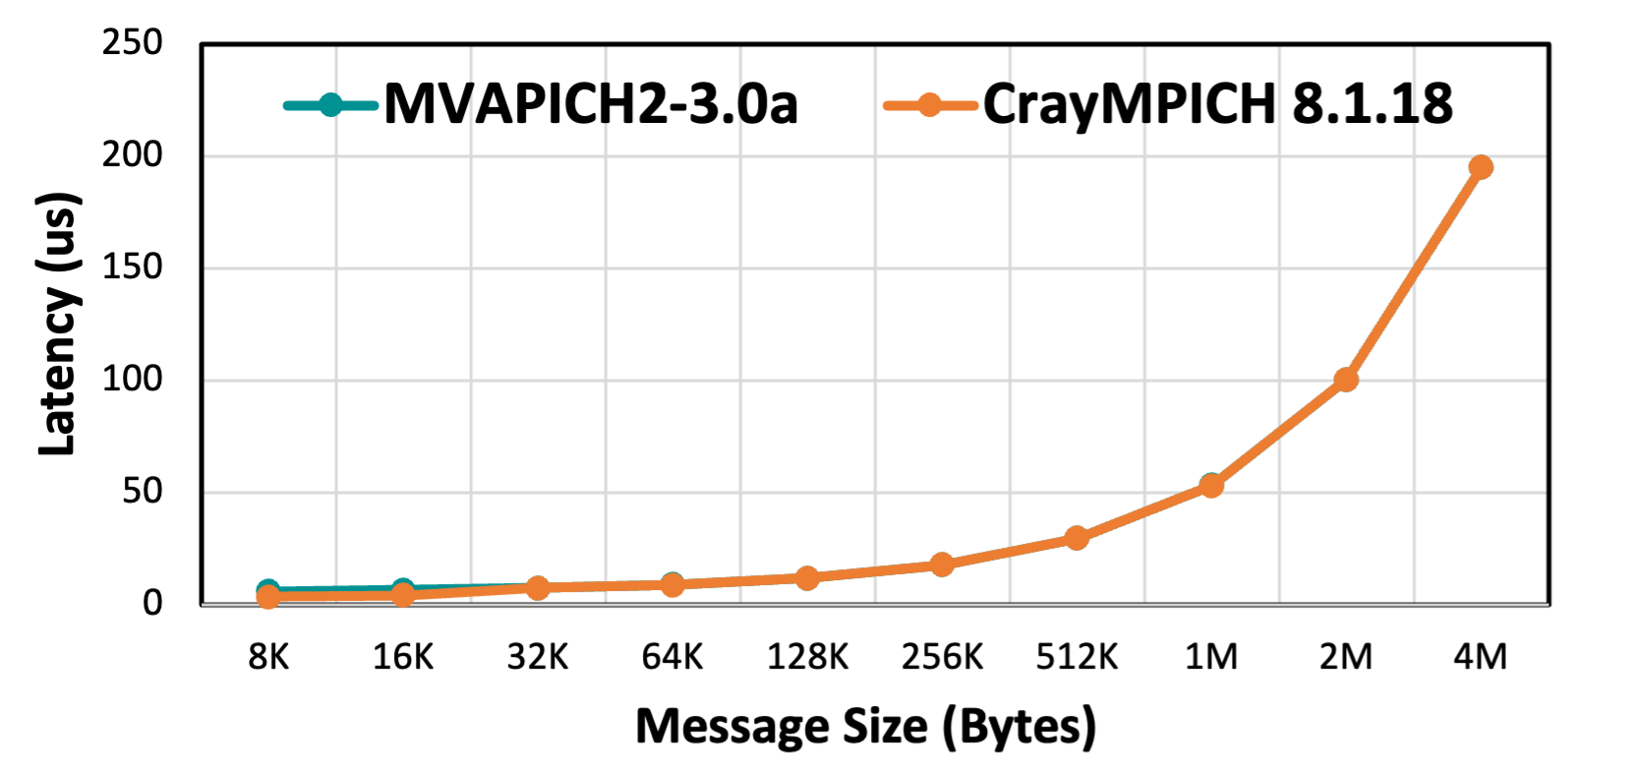
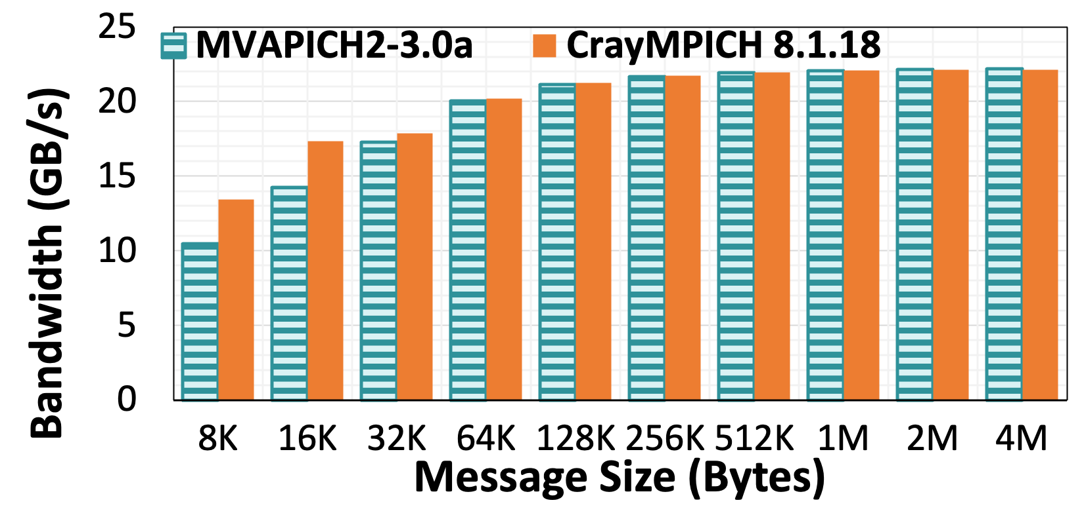

Point-to-Point Performance - Inter-Node CPU
LATENCY
BANDWIDTH
BI-BANDWIDTH
System with Slingshot-11 Networking

Slide 31
Performance Evaluation
Slingshot-11
GPU

Slide 32
Tioga Compute Node
CPU Architecture: AMD Trento 64 Cores/Nodes
GPU Architecture: AMD MI-250X
CPU-GPU Interconnect: AMD Infinity Fabric
System Interconnect: HPE Slingshot-11
Reference: https://hpc.llnl.gov/hardware/compute-platforms/tioga

Slide 33
Point-to-Point Inter-Node Performance
Latency:
Bandwidth:
Tioga - ROCm-5.3.0 (MI250-X GPUs)

Slide 34
Collective Performance
Bcast:
Alltoall:
Tioga - ROCm-5.3.0 (MI250-X GPUs) – 8 GPUs

Slide 35
Collective Performance
Gather:
Allgather:
Tioga - ROCm-5.3.0 (MI250-X GPUs) – 8 GPUs

Slide 36
Collective Performance
Reduce:
Allreduce:
Tioga - ROCm-5.3.0 (MI250-X GPUs) – 8 GPUs

Slide 37
References
Performance Evaluation of MPI on the Slingshot Interconnect. K. Khorassani, H. Subramoni, D. Panda. OpenFabrics Alliance 2022 Workshop (OFA 2022)., April 2022.
High Performance MPI over the Slingshot Interconnect: Early Experiences. K. Khorassani, C. Chen, B. Ramesh, A. Shafi, H. Subramoni, D. Panda Practice and Experience in Advanced Research Computing, Jul 2022. [Best Student Paper Award]
High Performance MPI Over Slingshot. K. Khorassani. MVAPICH User Group Conference (MUG 2022), August 2022.
High Performance MPI over the Slingshot Interconnect. K. Khorassani, C. Chen, B. Ramesh, A. Shafi, H. Subramoni, D. Panda. Accepted at Journal of Computer Science and Technology Special Issue, October 2022.

Slide 38



THANK YOU!
Network Based Computing
Laboratory
Network-Based Computing Laboratory
http://nowlab.cse.ohio-state.edu/
The High-Performance MPI/PGAS
Project
http://mvapich.cse.ohio-state.edu/
The High-Performance Big Data
Project
http://hibd.cse.ohio-state.edu/
The High-Performance Deep Learning
Project
http://hidl.cse.ohio-state.edu/

Slide 39

Several Talks at OSU Booth #4035
Mvapich.cse.ohio-state.edu

